Slide 1
Apple Freshness Detection and Depth Calculation System
Guided by, Submitted by,
Dr. Sreeja S Munavir Zaman P K
Department of EEE M4 RAA
No: 12

Slide 2
contents
Introduction
Literature review
Research gap
Objectives
Hardware components
Software components
Methodology
Timeline
References

Slide 3
Introduction
This project aims to develop a Mobile robot that can navigate to the desired location and can detect Freshness and ripeness of apples and also find depth of the Apple from the system.

Slide 4
Literature review
Title | C. Wang, T. Luo, L. Zhao, Y. Tang and X. Zou, "Window Zooming–Based Localization Algorithm of Fruit and Vegetable for Harvesting Robot," in IEEE Access, vol. 7, pp. 103639-103649, 2019, doi: 10.1109/ACCESS.2019.2925812.
Methodology | Two CCD Colour cameras are used for finding target location Window zooming algorithm is used Once the targets are recognized, the window zooming algorithm is employed to refine the recognition results and calculate the precise location of the targets. This algorithm adjusts the size of the recognition window based on the target's pixel ratio, which helps to improve the accuracy of target matching

Slide 5
Literature review
Title | D. Karakaya, O. Ulucan and M. Turkan, "A Comparative Analysis on Fruit Freshness Classification," 2019 Innovations in Intelligent Systems and Applications Conference (ASYU), Izmir, Turkey, 2019, pp. 1-4, doi: 10.1109/ASYU48272.2019.8946385.
Methodology | Comparison of various methods for classifying fruit freshness using image processing and machine learning techniques. Convolutional Neural Networks (CNNs), Support Vector Machines (SVMs) CNNs outperform traditional methods like SVMs due to their ability to automatically learn and extract relevant features from images.

Slide 6
Literature review
Title | T. Akter, S. Mahamud, M. Iqbal, T. A. Swarna, N. Nabi and M. S. Ahamed, "Local Vegetable Freshness Classification Using Transfer Learning Approaches," 2022 32nd International Conference on Computer Theory and Applications (ICCTA), Alexandria, Egypt, 2022, pp. 90-95, doi: 10.1109/ICCTA58027.2022.10206162
Methodology | To classify the freshness of local vegetables using transfer learning techniques. Utilized pre-trained deep learning models (e.g., VGG16, ResNet50) and fine-tuned them for vegetable freshness classification. The transfer learning models demonstrated high accuracy and robustness in classifying vegetable freshness

Slide 7
Literature review
Title | W. Kharamat, M. Wongsaisuwan and N. Wattanamongkhol, "Durian Ripeness Classification from the Knocking Sounds Using Convolutional Neural Network," 2020 8th International Electrical Engineering Congress (iEECON), Chiang Mai, Thailand, 2020, pp. 1-4, doi: 10.1109/iEECON48109.2020.229571
Methodology | Utilized MFCC and CNN for durian sound analysis. Dataset preparation-Durian knocking sound is made by knocking a durian a few times using rubber tipped stick.then we record its sound at a sampling frequency of 16 khz and 16 bits mono audio with randomized positions of the recording microphone MFCC used for feature extraction. Achieved 90.78% validation, 89.47% testing accuracy."

Slide 8
Literature review
Title | Developed DeRiBa-Fuz architecture using fuzzy logic and RGB-GLCM classifier. Utilized 73% training, 27% testing datasets across 7 categories of tomato ripeness. Achieved 100% accuracy in five ripeness categories and 96.55% accuracy in one, leveraging fuzzy logic and RGB-GLCM extraction."
Methodology | Developed DeRiBa-Fuz architecture using fuzzy logic and RGB-GLCM classifier. Utilized 73% training, 27% testing datasets across 7 categories of tomato ripeness. Achieved 100% accuracy in five ripeness categories and 96.55% accuracy in one, leveraging fuzzy logic and RGB-GLCM extraction.

Slide 9
Literature review
Title | : M. A. Gonzales, J. F. M. Datingaling, L. A. Herman and E. H. D. Alon, "Gas Sensor-Based Nondestructive Testing for Jackfruit Ripeness Level," 2023 IEEE International Conference on Automatic Control and Intelligent Systems (I2CACIS), Shah Alam, Malaysia, 2023, pp. 241-246, doi: 10.1109/I2CACIS57635.2023.10193593
Methodology | Utilized gas sensors (MQ3, MQ5, MQ7, MQ135) and a microcontroller in a prototype device Achieved 96% accuracy displaying ripeness on an LCD. Preheated MQ gas sensors for precise readings, sensitive to specific jackfruit gases. Sensor resistance values determined gas concentrations, establishing a correlation between gas emissions and ripeness.

Slide 10
Research gap
Existing systems are rare for finding the depth of an apple and detecting its freshness together.
Therefore, this project aims to develop a mobile robot that can navigate to the desired location, detect the freshness of apples, and also determine the depth of the apples.

Slide 11
Objectives
To use Yolo v8 algorithms for identifying freshness of apples(fresh or rotten).
To use ESP32 stereo camera for finding depth of the apples.
To develop a mobile robot capable of navigation which can be used in Apple freshness detection.
To use Yolo v8 algorithms for identifying ripeness of apples(ripe,unripe or overripe).

Slide 12
Hardware Components
ESP32 Cameras (2 units)
Raspberry Pi 4 Model 2GB
Gear Motors: SPG30E-60K DC Geared Motor with Encoder 75 RPM(12V)
Motor Drivers: L298N
Power Supply: 12 V
Arduino UNO
Keyboard: For teleoperation control.

Slide 13
Hardware Components
ESP32 Cameras (2 units)
Wireless: Wi-Fi (802.11 b/g/n) and Bluetooth (4.2, BLE)
Resolution: Up to 1600x1200 pixels (OV2640)
Programming: Compatible with Arduino IDE, Micropython
Focul length: 3.6 mm
SPG30E-60K DC Geared Motor with Encoder 75 RPM (12V)
Voltage: 12V
No-load Speed: 75 RPM
Stall Torque: 12 kg.cm
Current:
No-load: 0.3A
Stall: 2.4A

Slide 14
Hardware Components
Raspberry Pi 4 Model 2GB
Memory: 2GB LPDDR4-3200 SDRAM
Ports:
2 USB 3.0 ports
2 USB 2.0 ports
2 Micro HDMI ports (supports up to 4K resolution)
40 GPIO pins
Camera interface (CSI)
Display interface (DSI)
MicroSD card slot for loading OS and data storage

Slide 15
Hardware Components
Motor Drivers: L298N
Operating Voltage: : 5V to 35V
Microcontroller:
ATmega328POperating
Voltage: 5V
Digital I/O Pins: 14
Analog Input Pins: 6
Clock Speed: 16 MHz

Slide 16
Software Components
OpenCV
YOLOv8
Python

Slide 17
Proposed Block diagram
Mobile Robot
Rasberry Pi
Teleoperation Control
ESP32 Cameras (2 units for stereo vision)
Image capture (capture stereo images)
Runs ROS
Executes movement commands
Depth Calculation (Using disparity information)
Freshness Detection Module (Classifies fresh or rotten)
Object Detection (YOLOv8 Algorithm)
Image Processing (OpenCV for camera calibration)
Result Display (Shows freshness and depth info)

Slide 18
Methodology
Object detection
Detecting apple freshness using YOLOv8 involves
Training the model with a dataset containing images of apples at different freshness stages
Using the trained model detecting the freshness of apples in real time.
Steps
Dataset Collection
Annotation
Data Split: Divide the dataset into training, validation, and testing sets.

Slide 19
Methodology
Training the Model
Model Evaluation: To ensure it can accurately detect apple freshness.
Testing: Use the trained model to check performance on new images containing apples or real time detection of apples
This same methods also used for detecting apple ripeness

Slide 20
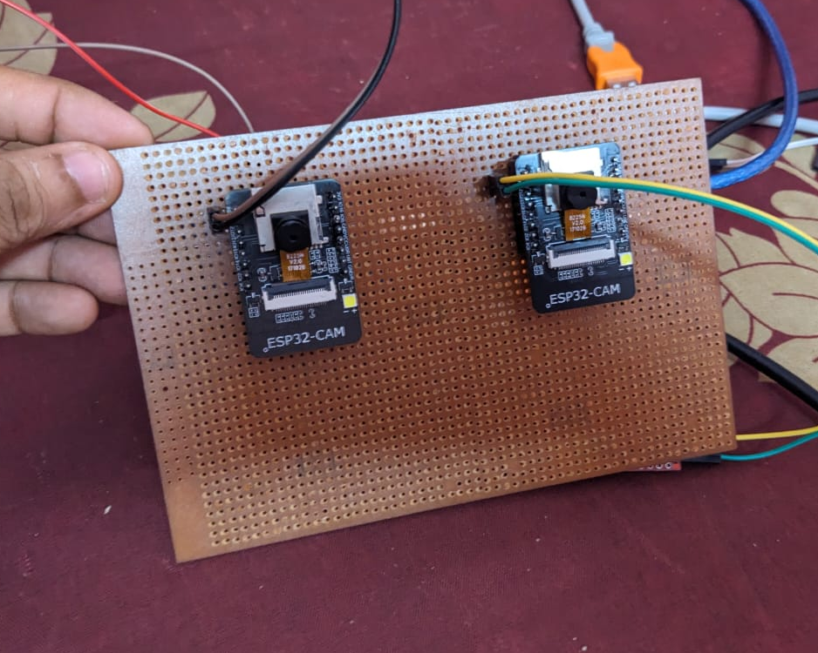
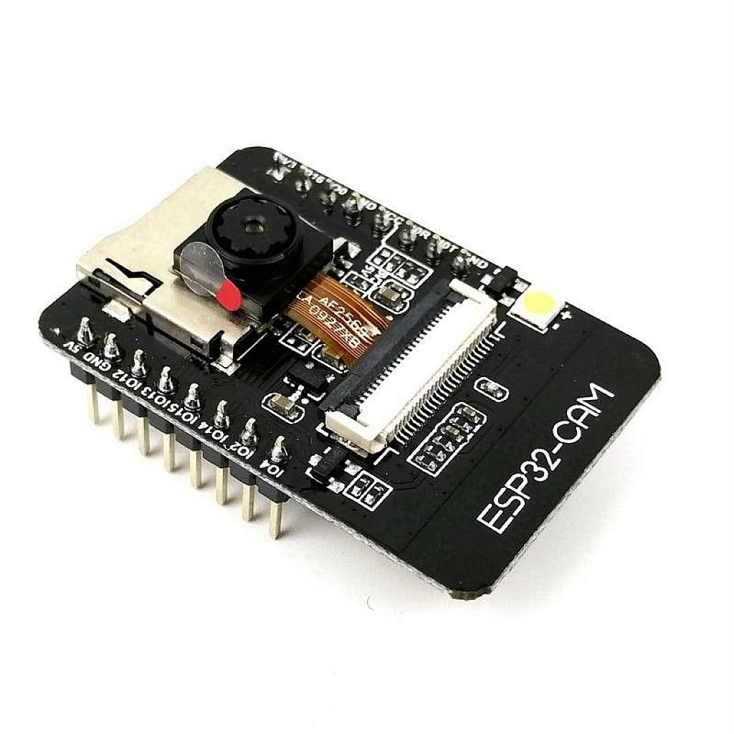
Methodology
Stereo Camera Setup:
Mount the two ESP32 cameras on the mobile robot with a fixed baseline distance.
Calibrate the cameras for stereo vision to obtain depth information.
Figure:2
Figure:1

Slide 21
Methodology
Stereo camera setup:
Triangulation method is used for finding depth
Here's a basic outline of the process:
Camera Setup: Place two ESP32 cameras at a known distance apart from each other
Image Capture: Simultaneously capture images from both cameras of the same scene or object.
Disparity Calculation: Once corresponding points are matched, calculate the disparity between the two points.
The disparity is inversely proportional to the depth of the object (closer objects have larger disparities).

Slide 22
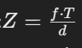
Methodology
Depth Calculation: Use the disparity information along with the baseline distance and the focal length of the cameras to calculate the depth for each pixel in the image using the equation :
Z is the depth of the object from the camera,
f is the focal length of the camera (in pixels),
T is the distance between the two camera lenses (baseline),
d is the disparity of the object in the stereo images (the difference in x-coordinates of the object's location in the left and right images).​

Slide 23
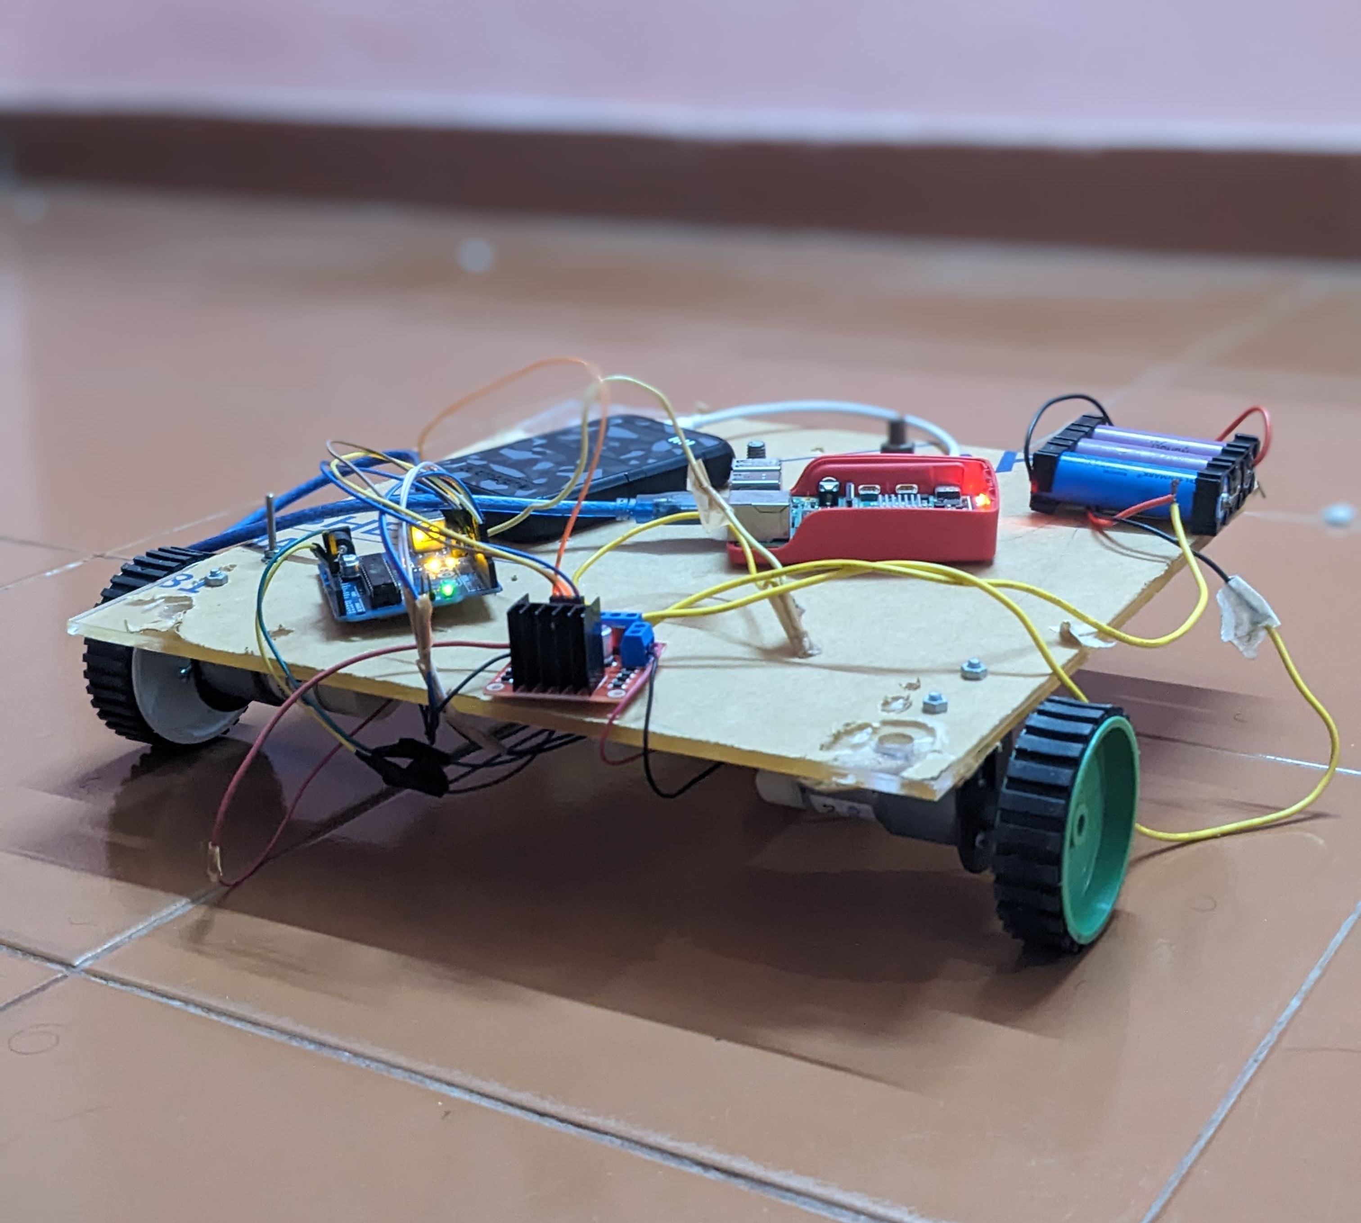
Methodology
Mobile Robot Integration:
Integrate the ESP32 cameras with the mobile robot platform.
Teleoperation Control:
Use the teleop_twist_keyboard ROS package to control the robot with a keyboard.
Raspberry Pi executes movement commands received from the keyboard input.
Figure:3

Slide 24
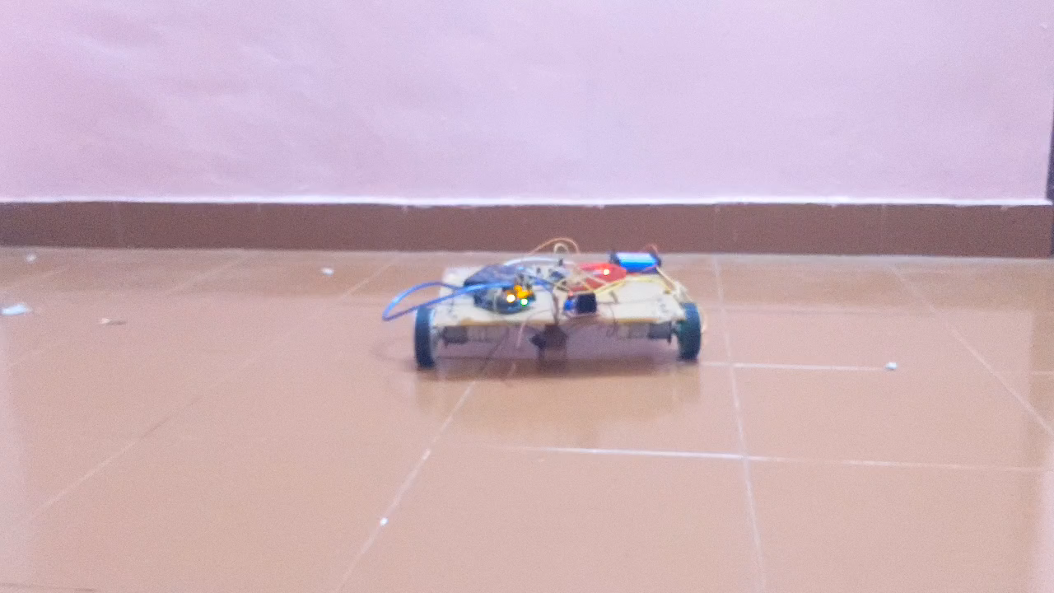
Methodology
Use the keyboard to send movement commands to the robot:
I: Move forward
,: Move backward
J: Turn left
L: Turn right
K: Stop

Slide 25
Methodology
Start
Initialize System
Teleoperation Control
Capture Stereo Images
Image Processing
Object Detection
Freshness Detection
Depth Calculation
Display Results
End

Slide 26
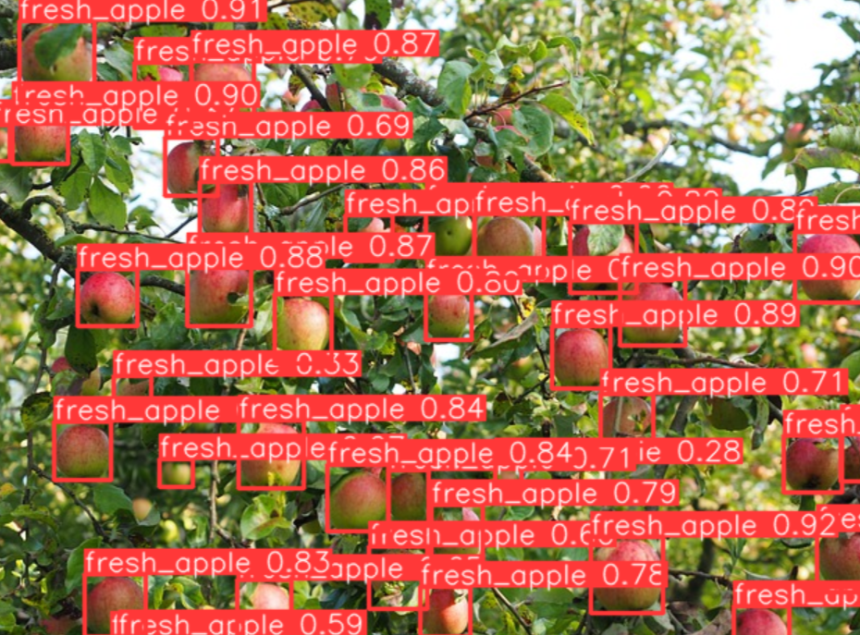
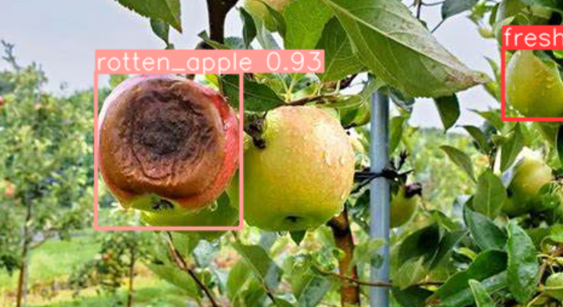
Results
By using the YOLOv8 algorithm, apples are correctly detected as either fresh or rotten in real time.
Detection Accuracy:
Fresh Apples: 97%
Rotten Apples: 86%
Figure:5
Figure:6

Slide 27
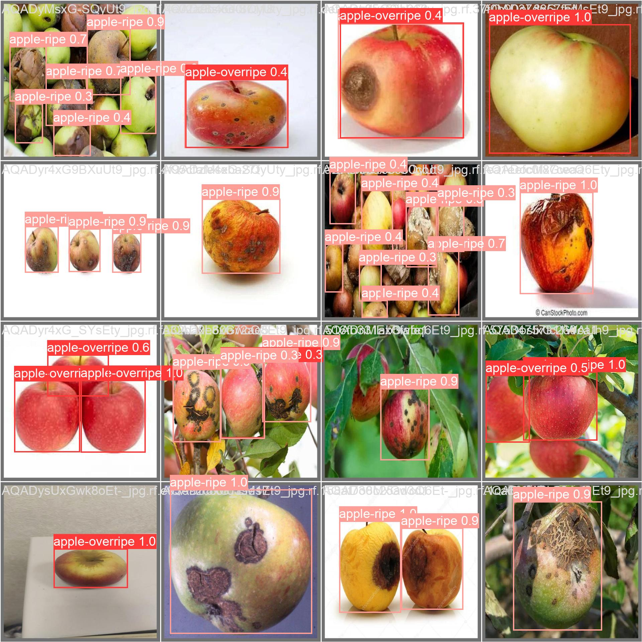
Results
By using the YOLOv8 algorithm, apples are correctly detected as either ripe,unripe or overripe.
Detection Accuracy: 90%
Figure:5
Figure:6

Slide 28
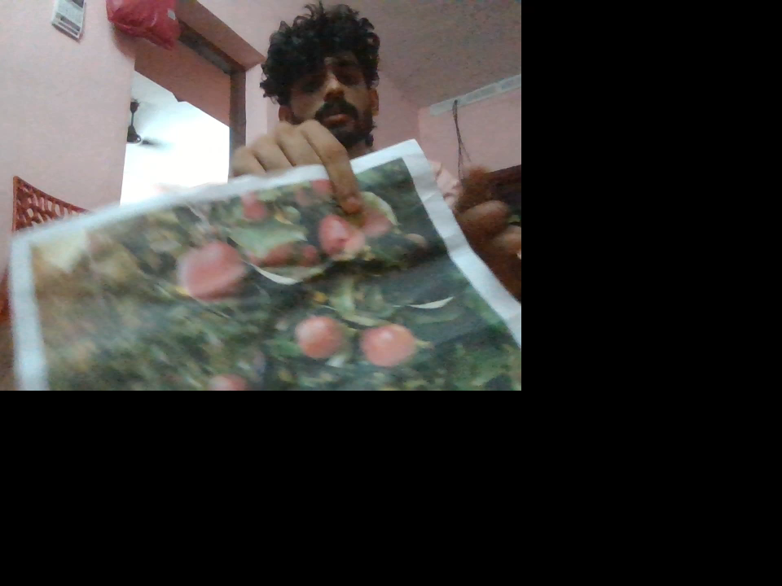
Results
Real time detection of fresh or rotten apples are given below

Slide 29
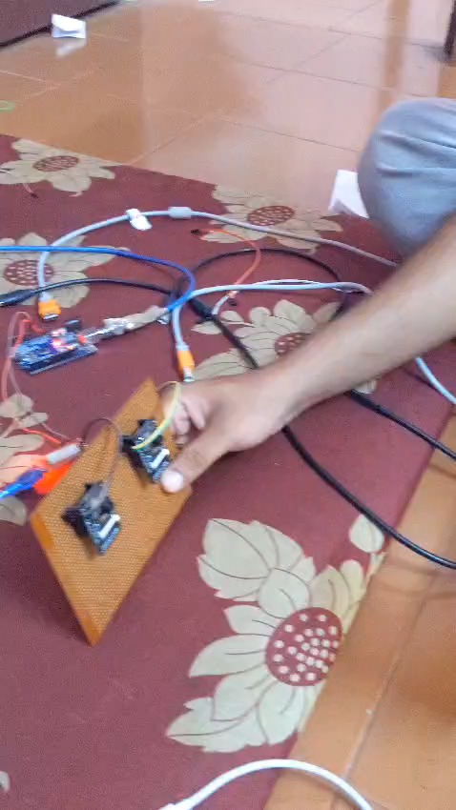
Results
The stereo camera setup utilized a baseline distance of 7 cm, ensuring optimal depth calculation precision.
The calibration accuracy of the cameras was high, contributing to reliable depth measurement.
Figure:7

Slide 30
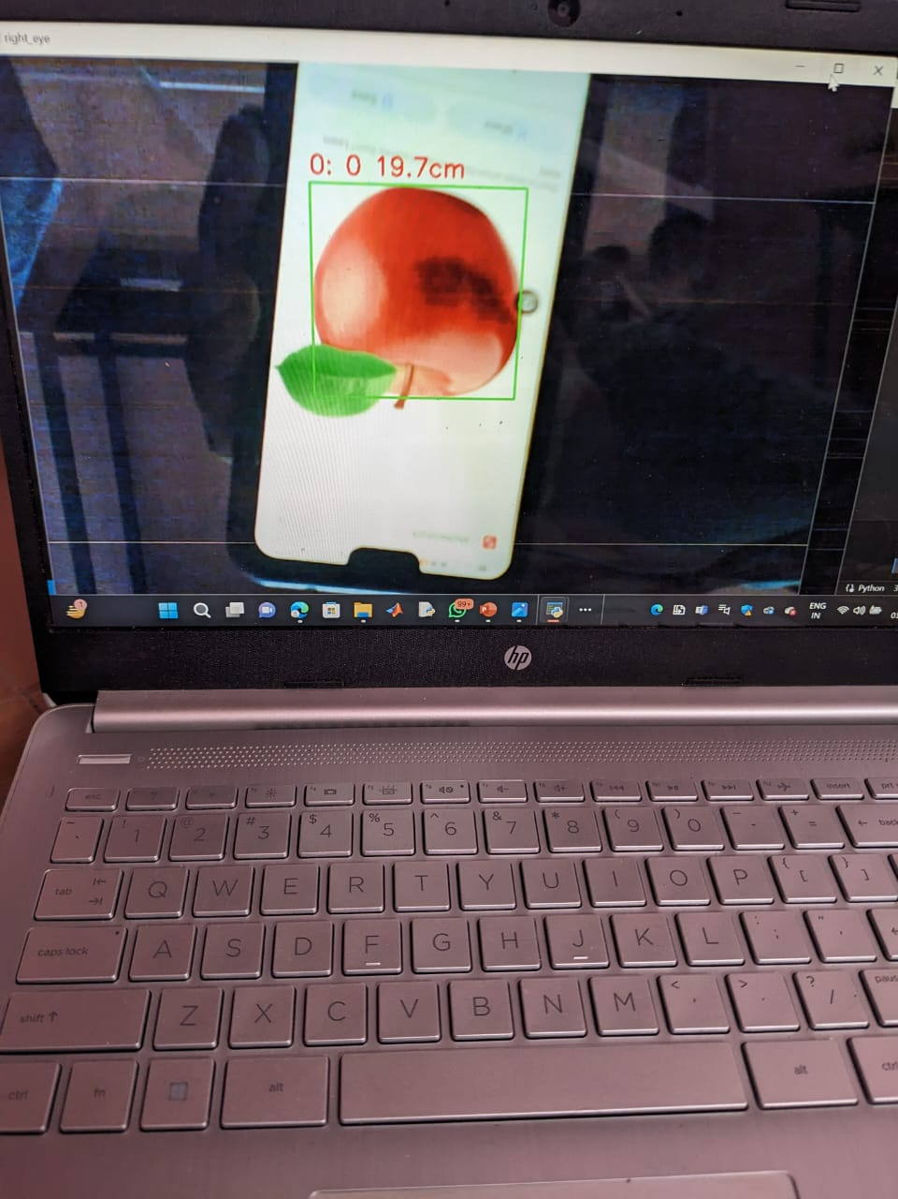
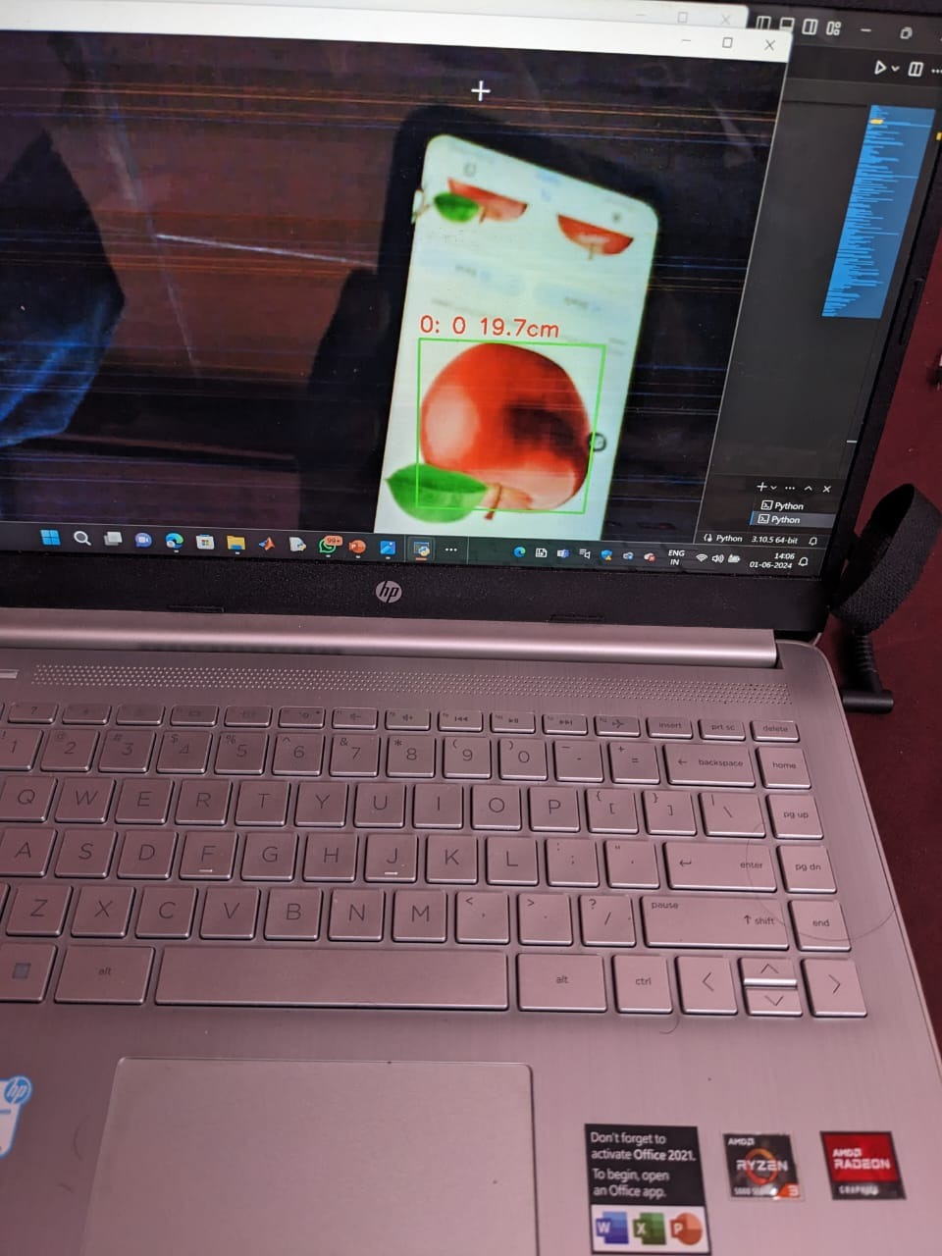
Results
Images from left and right ESP32 Cameras are given below.And the distance from camera to apple is also shown in both frames
Left
Right
Figure:8
Figure:9

Slide 31
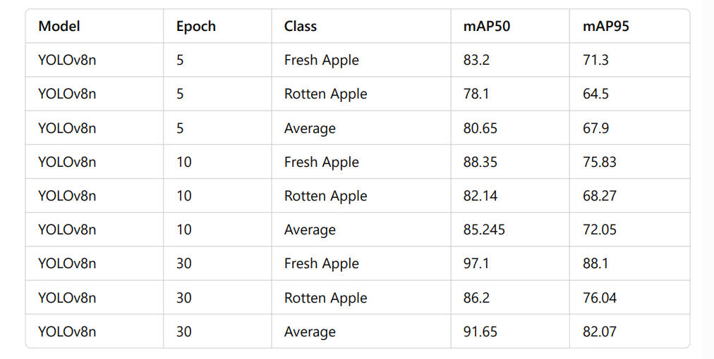
Results
The results of our YOLOv8 model showcase its strong performance in detecting both fresh and rotten apples. Across different training epochs, the model consistently achieves high mean Average Precision (mAP) values for both classes

Slide 32
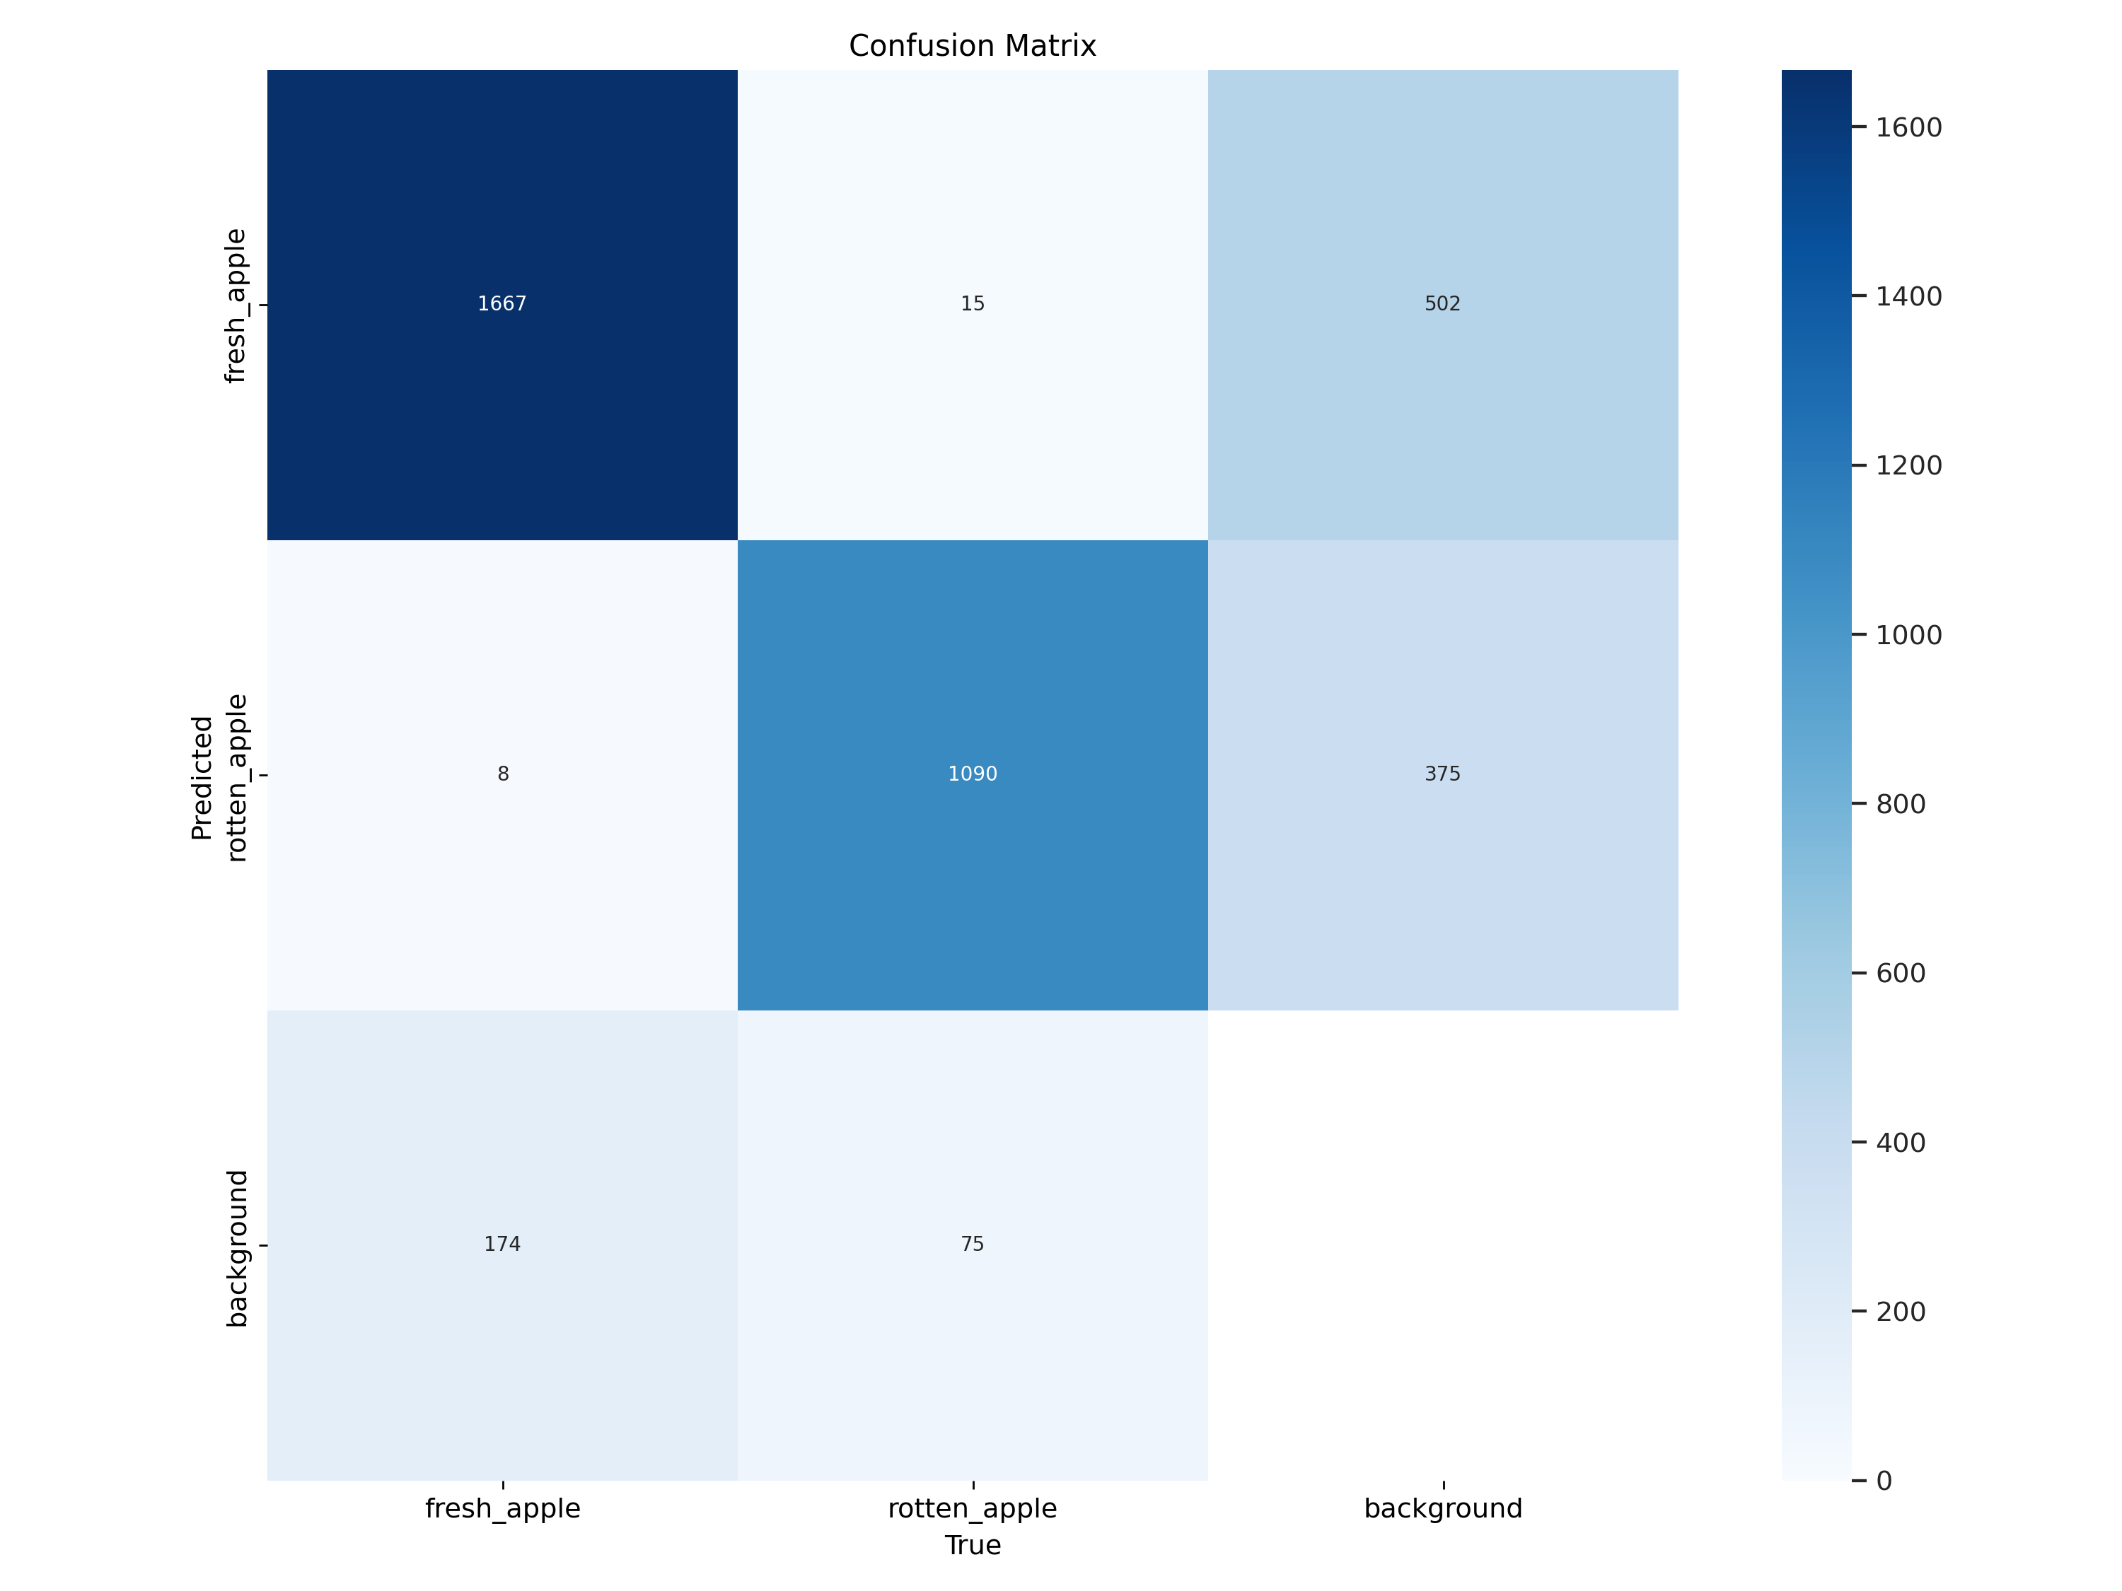
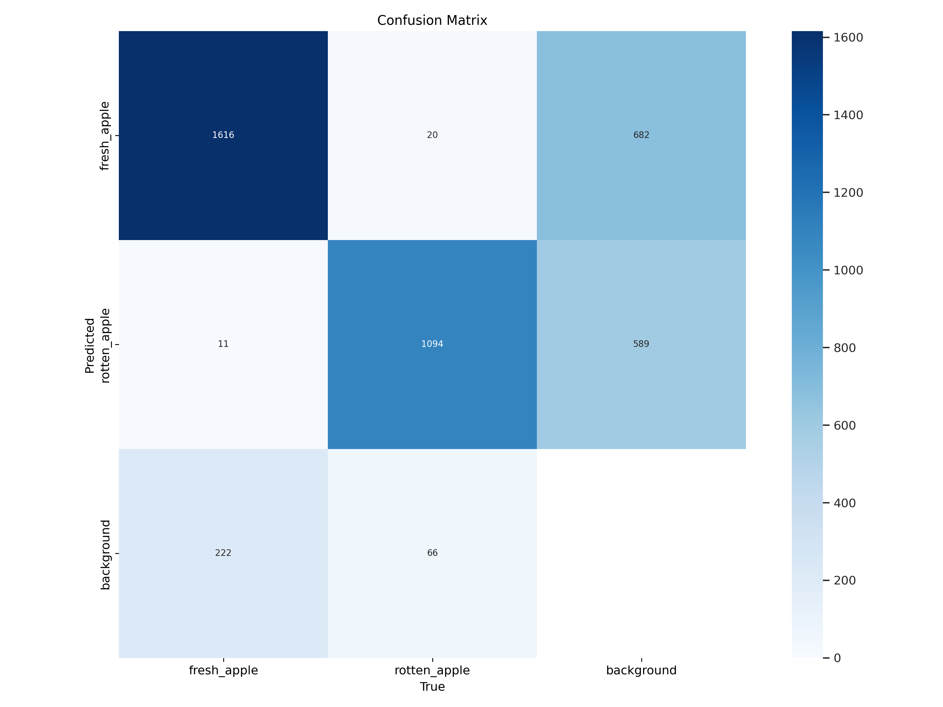
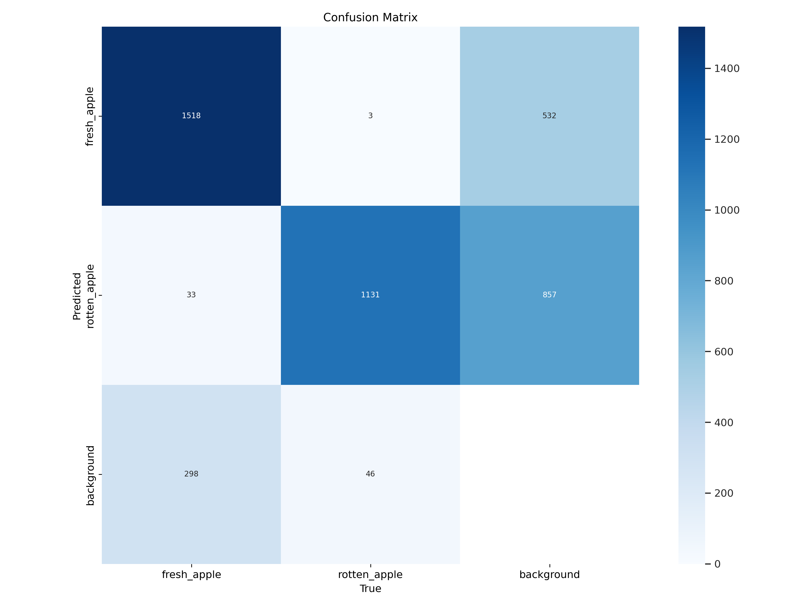
Results
Confusion matrices for different training epochs are given below
Epochs:30
Epochs:10
Epochs:5

Slide 33
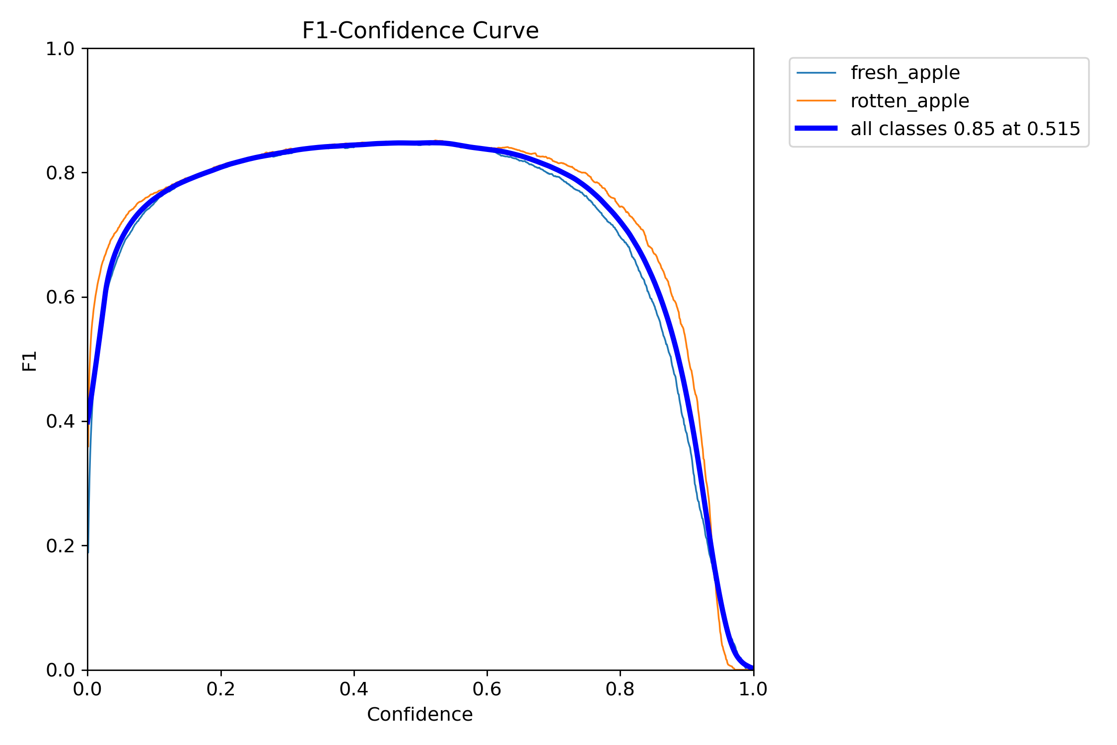
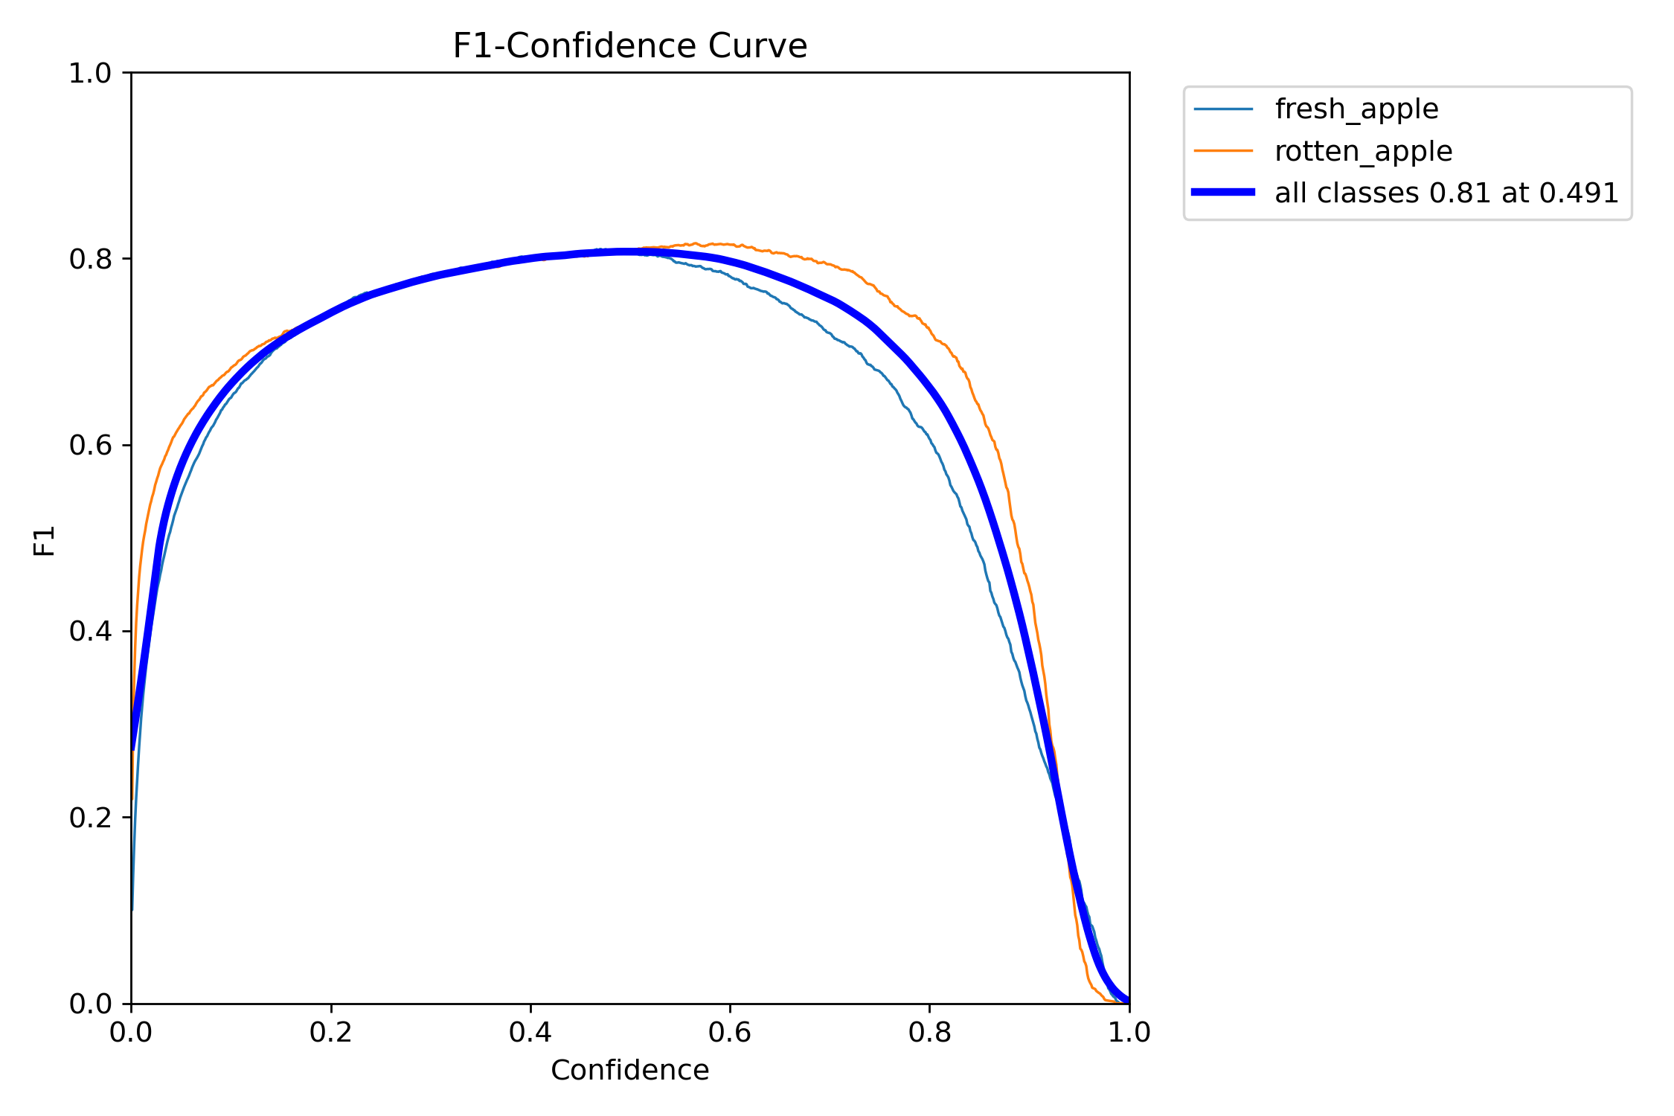
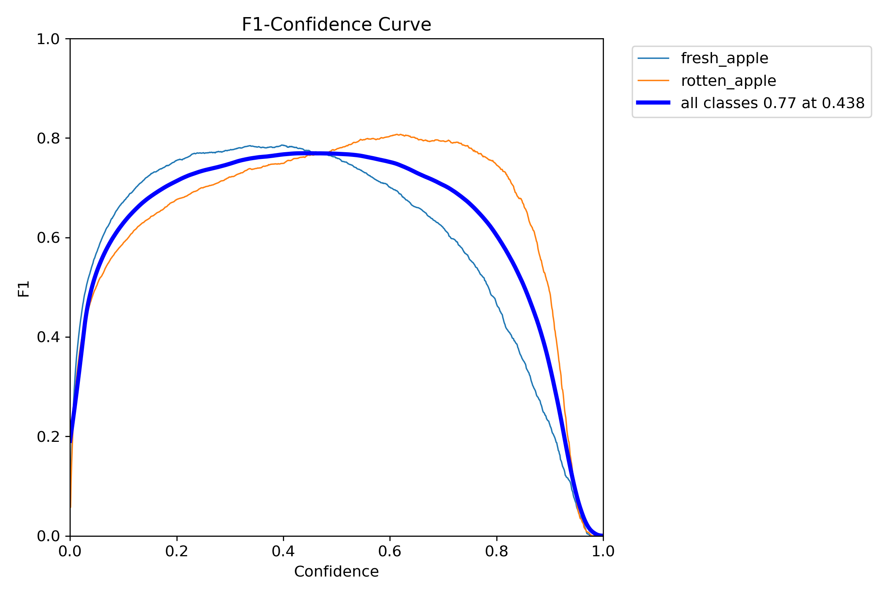
Results
F1–Confidence curves for different training epochs are given below.
Epochs:30
Epochs:10
Epochs:5

Slide 34
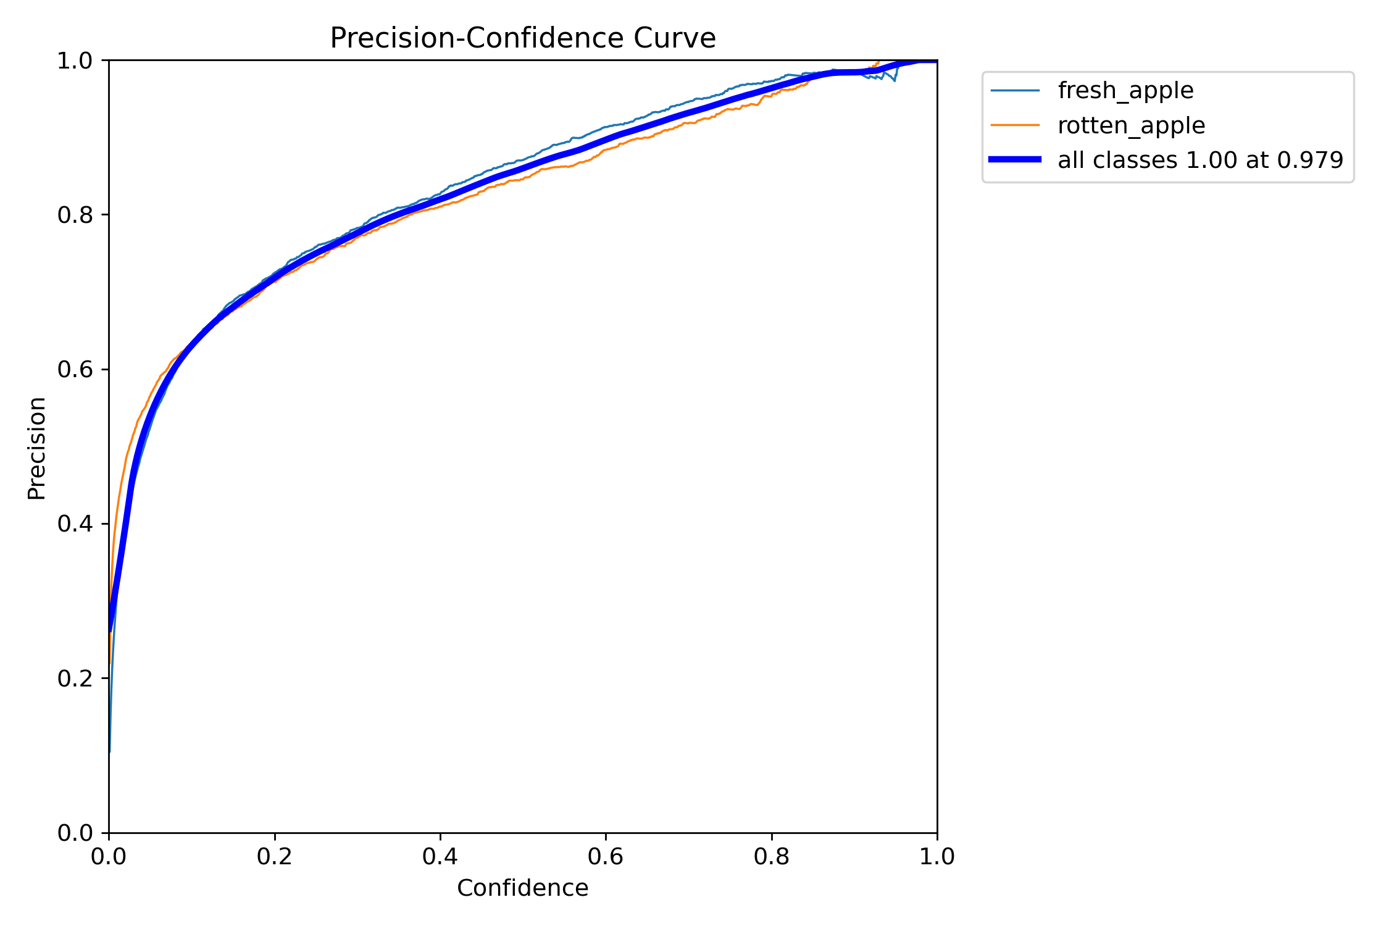
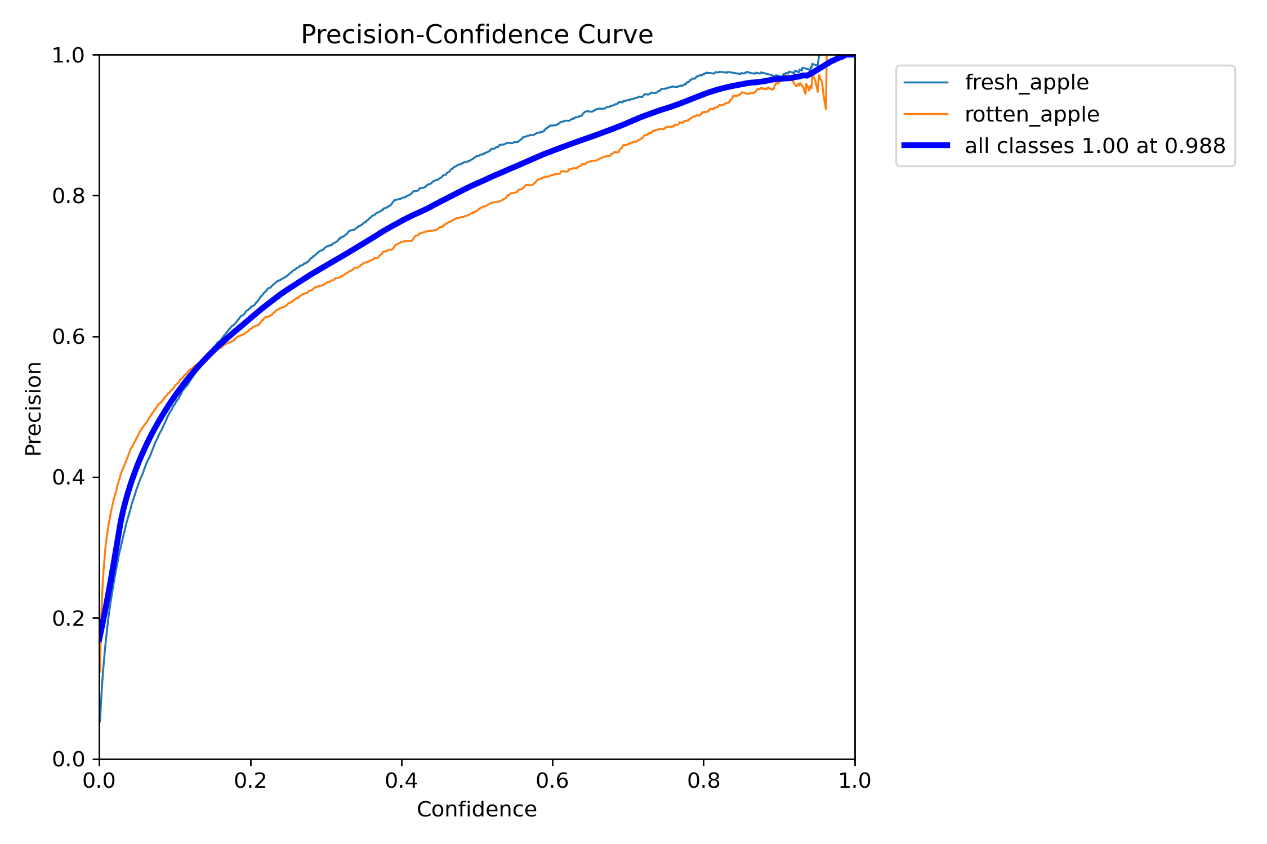
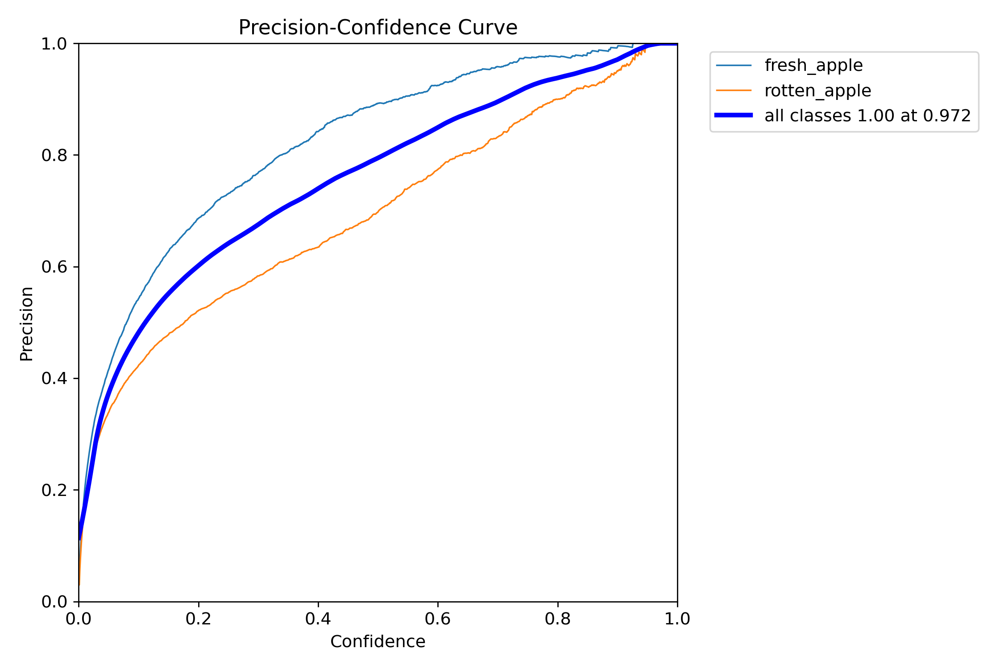
Results
Precision–Confidence curves for different training epochs are given below
Epochs:30
Epochs:10
Epochs:5

Slide 35
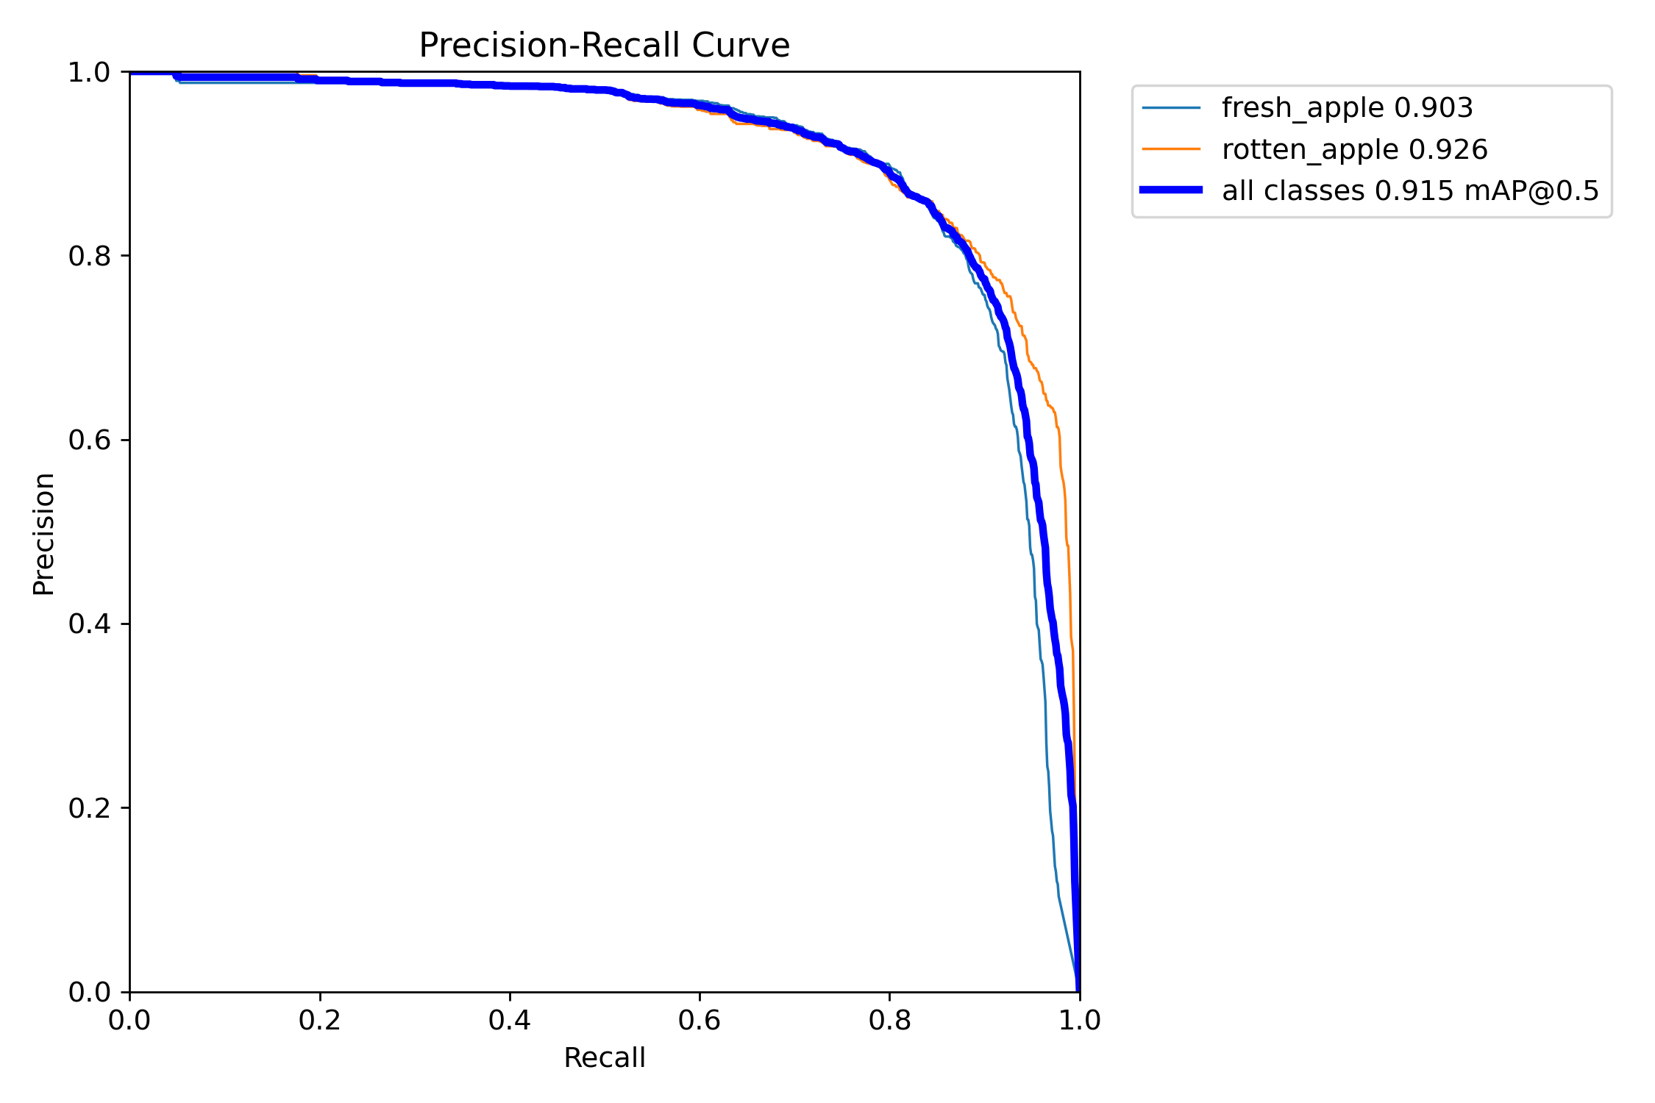
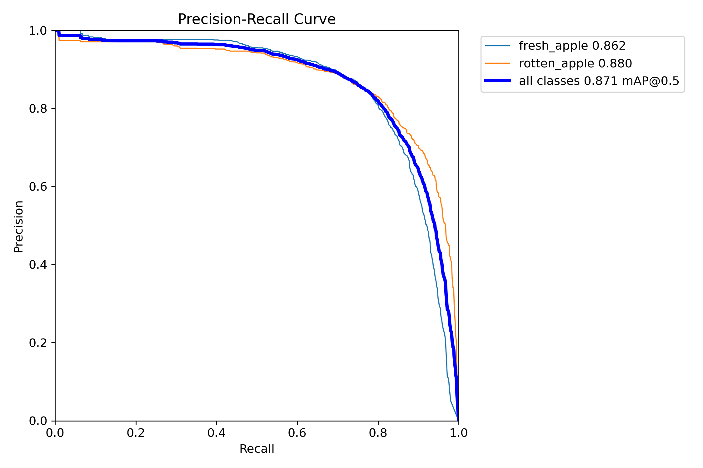
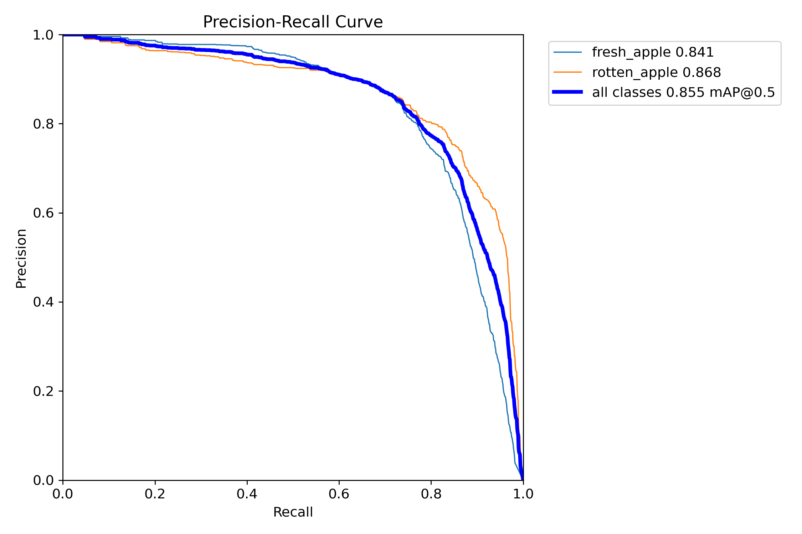
Results
Precision-Recall curves for different training epochs are given below
Epochs:30
Epochs:10
Epochs:5

Slide 36
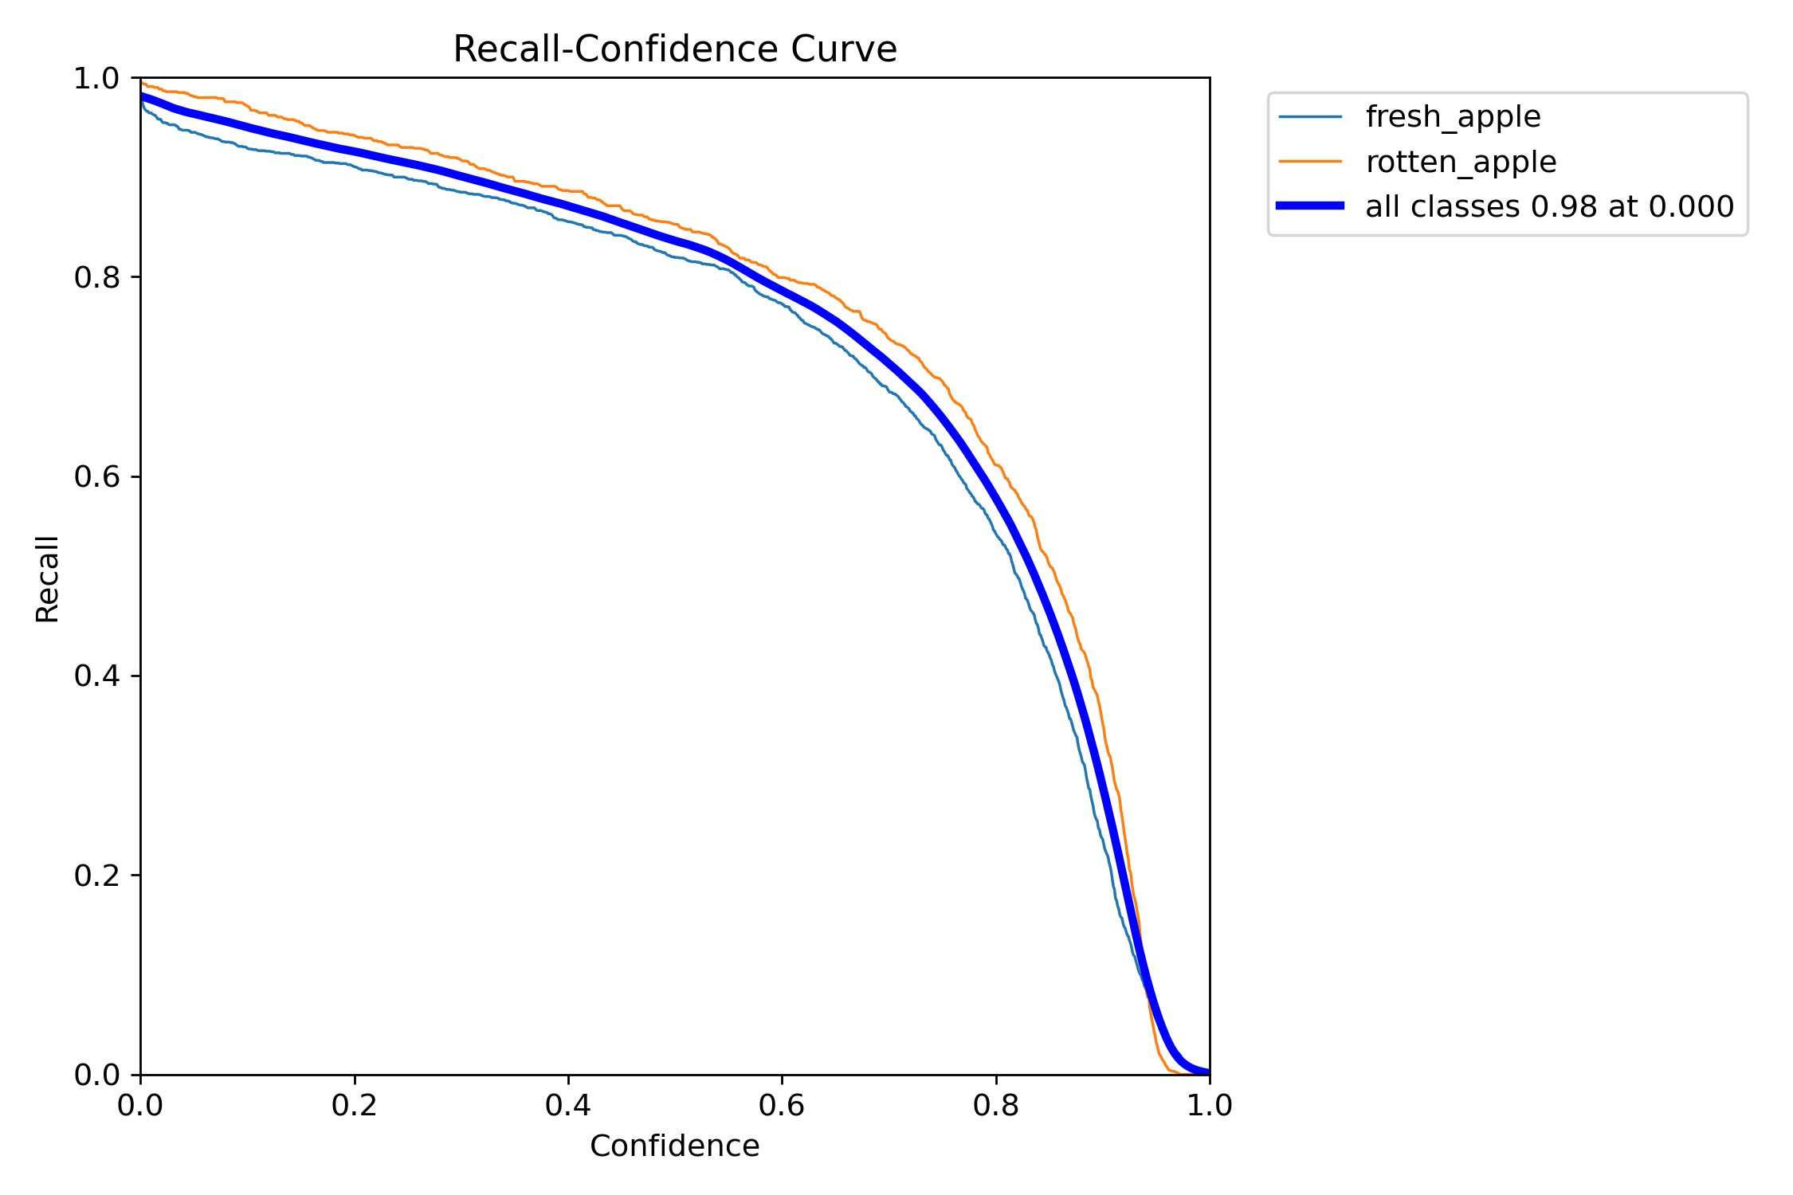
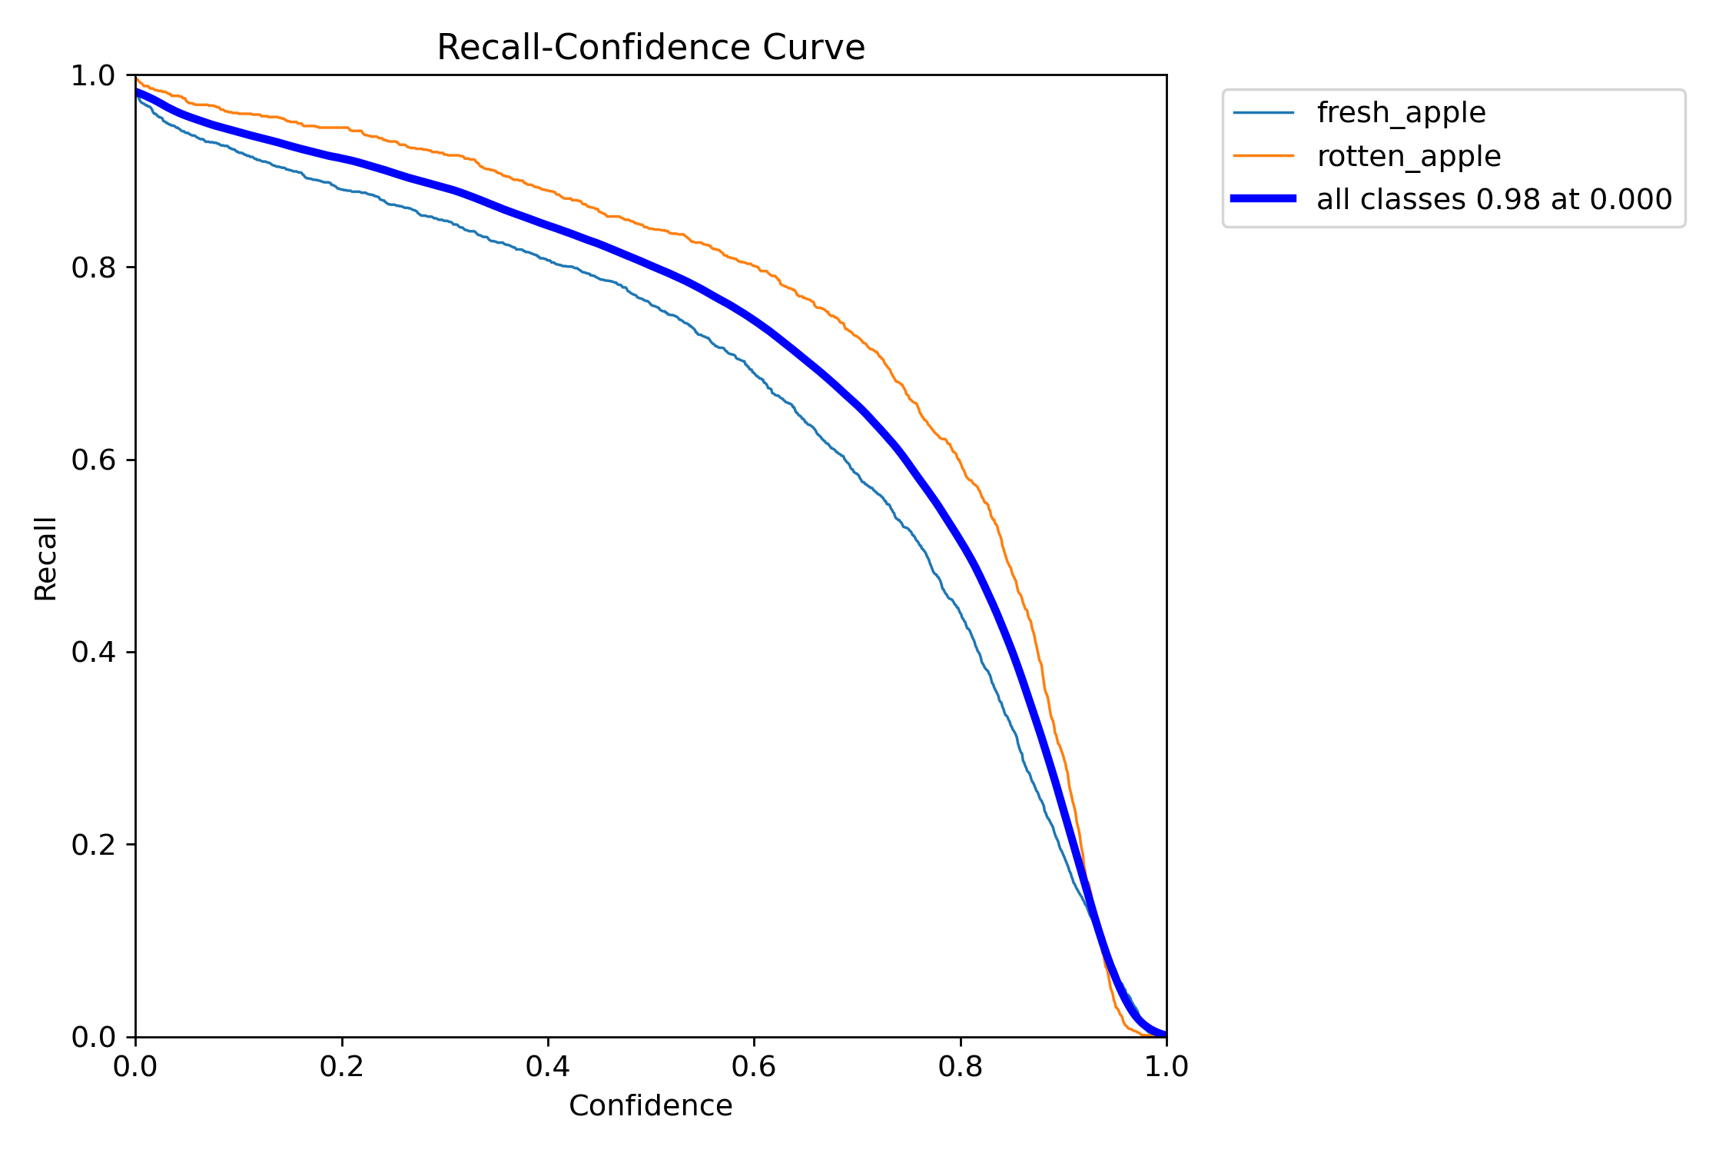
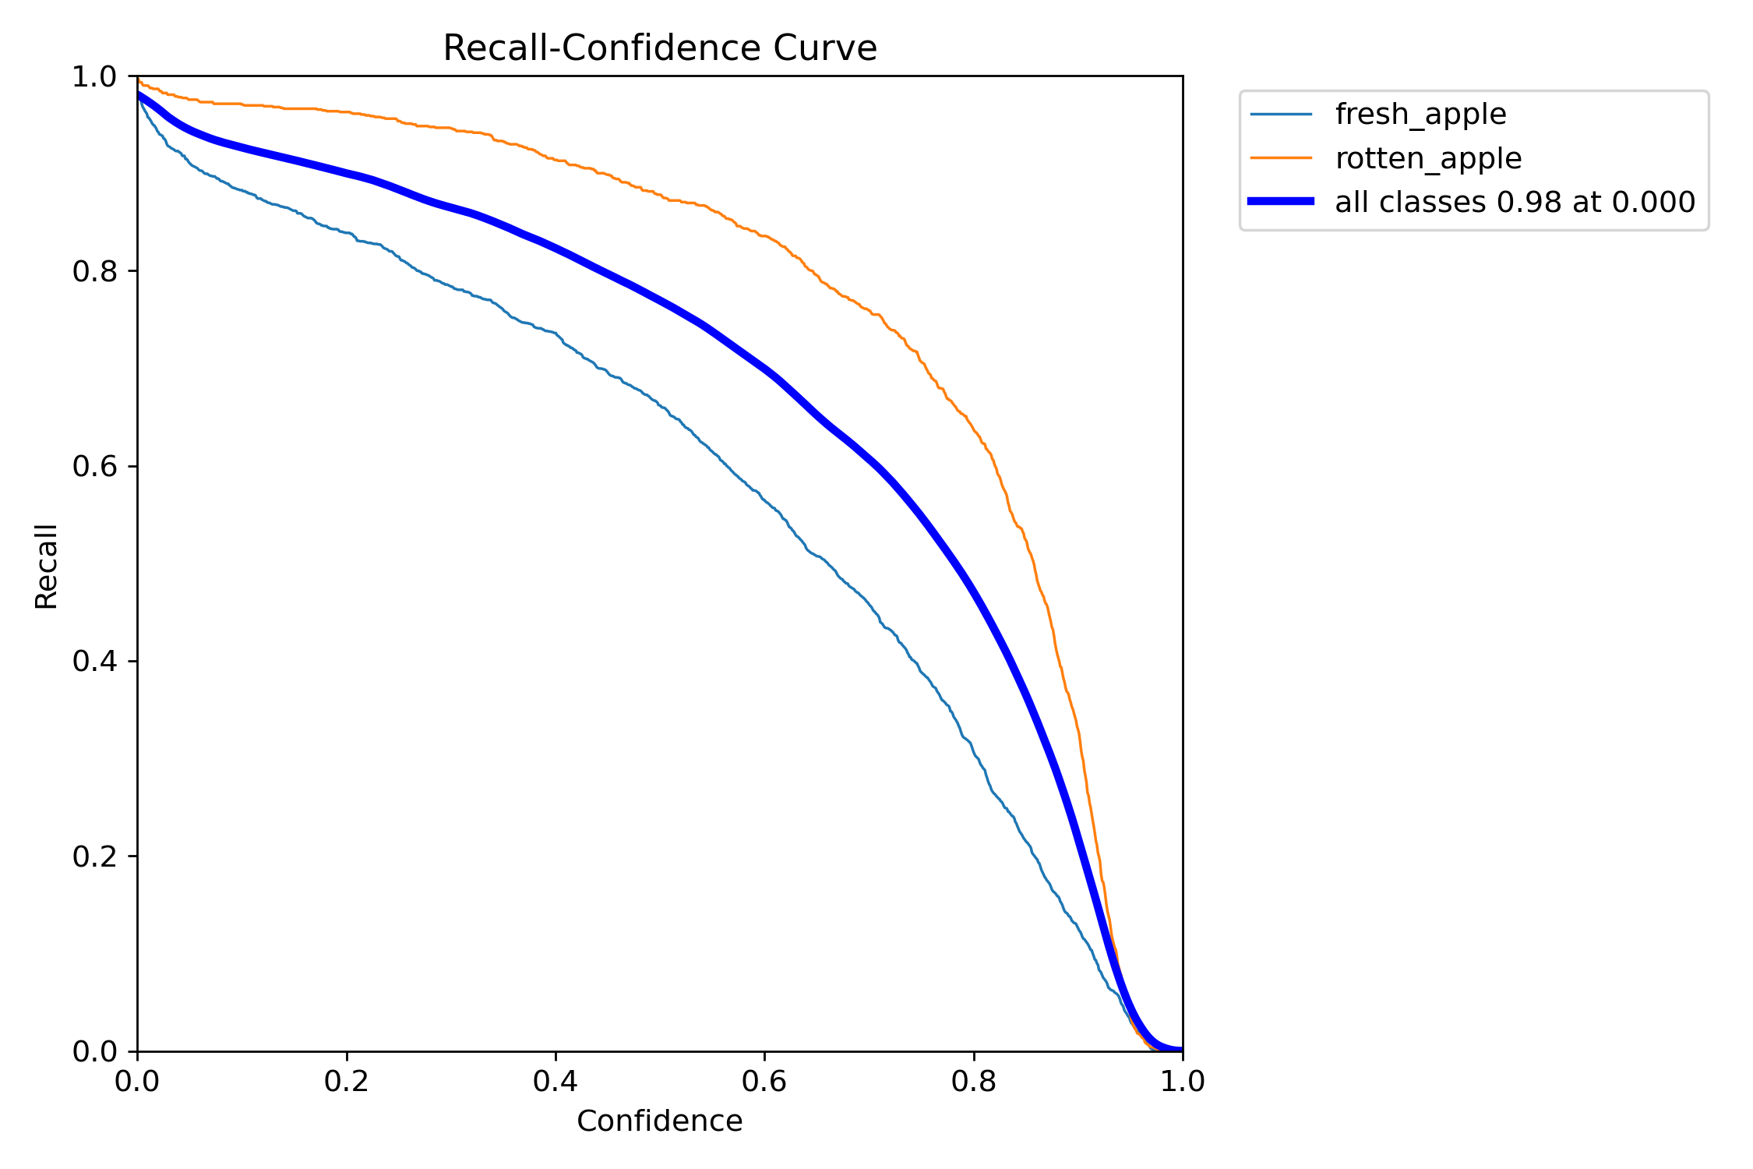
Results
Recall–Confidence curves for different training epochs are given below
Epochs:30
Epochs:10
Epochs:5

Slide 37
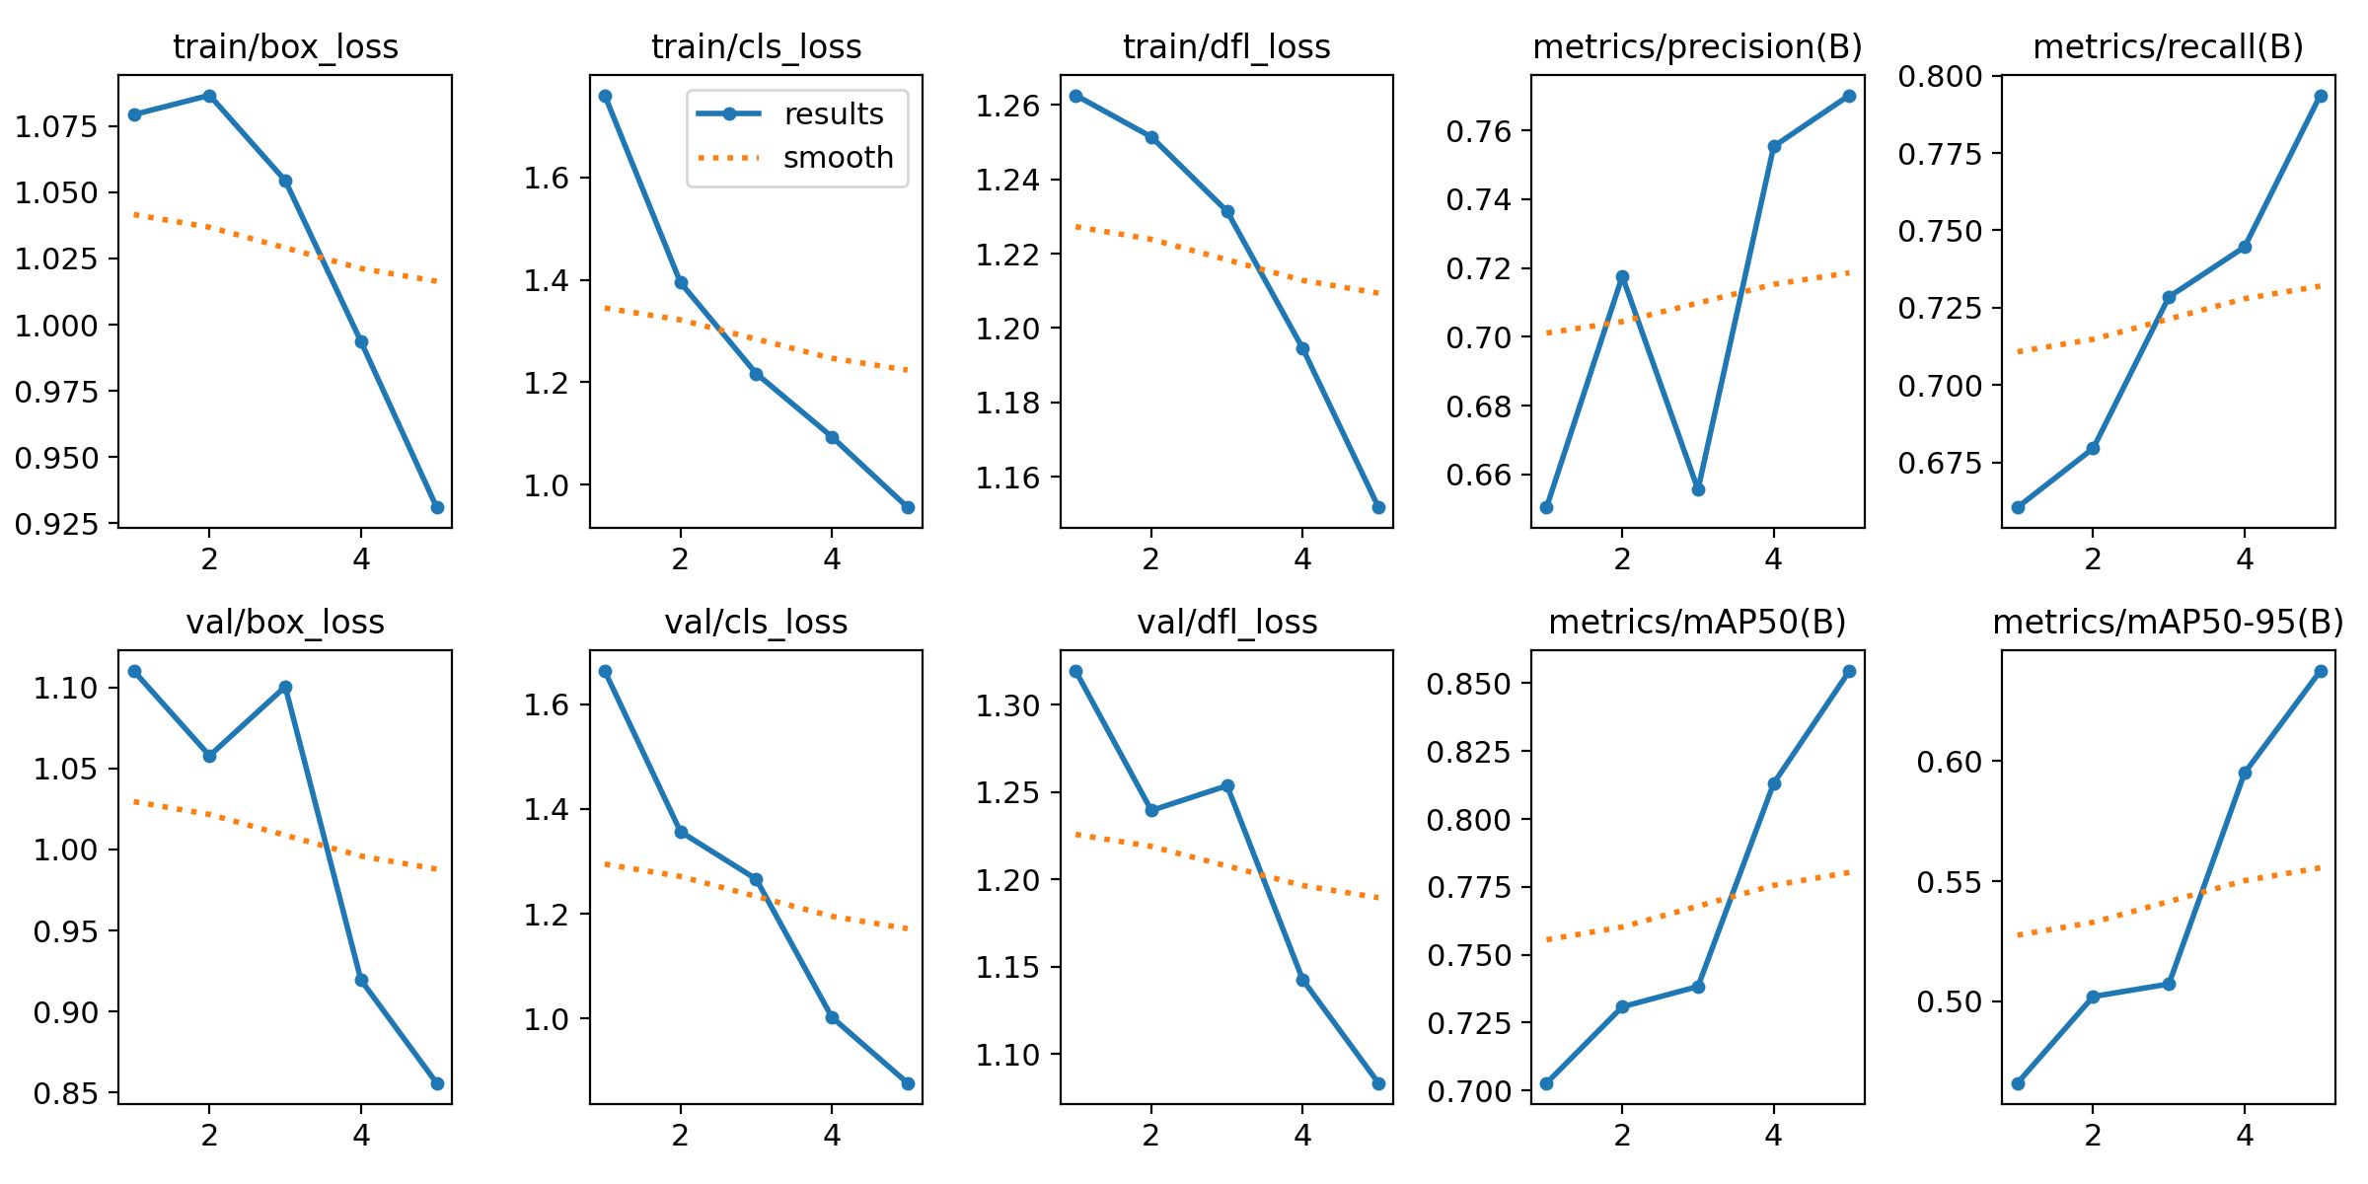
Results
Training and validation graphs after 5epochs.

Slide 38
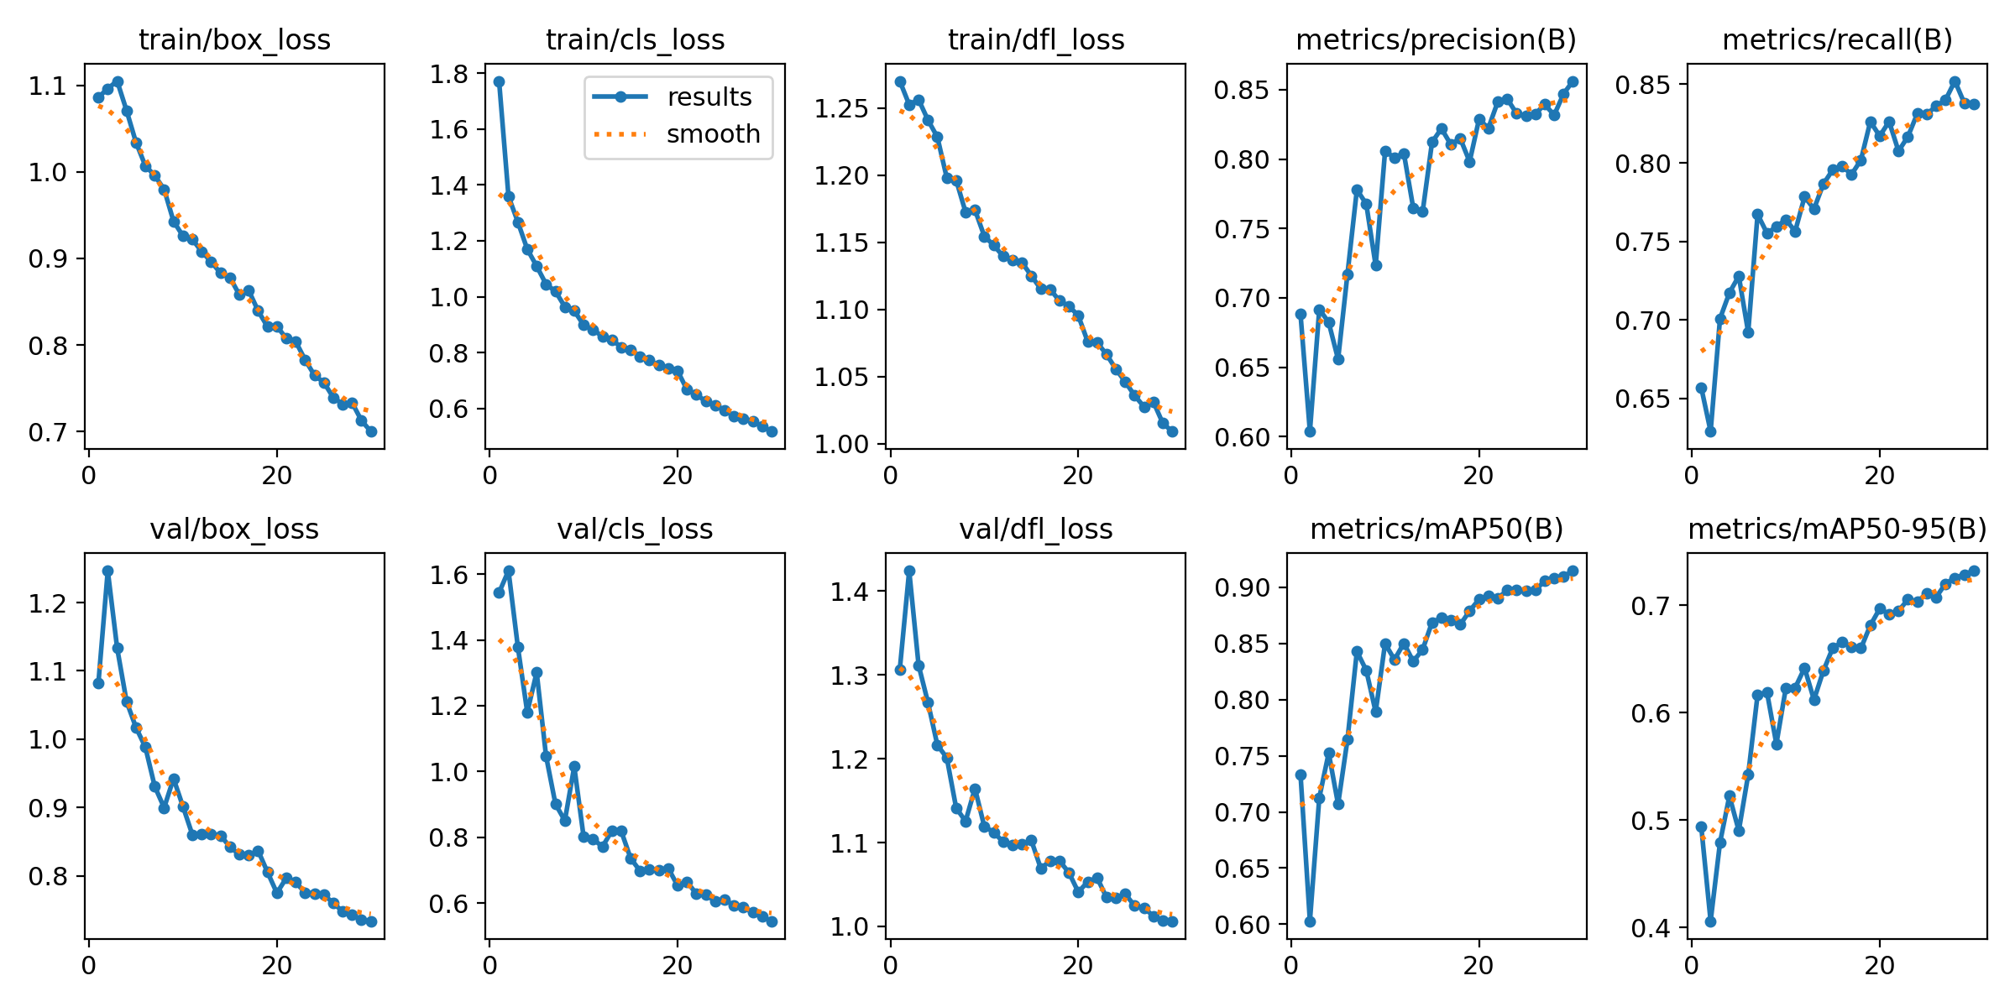
Results
Training and validation graphs after 30 epochs.

Slide 39
Conclusion
From the analysis of the YOLOv8n model over different training epochs (5, 10, and 30), we can draw several insights:
Accuracy and mAP50: As the number of epochs increases, both the mAP50 and accuracy improve significantly.
For fresh apples, mAP50 increases from 83.2 at 5 epochs to 97.1 at 30 epochs, while for rotten apples, it rises from 78.1 to 86.2.
This indicates that more training epochs lead to better model performance and higher accuracy in detecting both classes.
Precision and Recall: Both precision and recall are likely improving with more epochs.

Slide 40
Conclusion
Confidence: Increased epochs also typically lead to higher confidence scores for predictions, as the model becomes more certain about its detections due to better training.
Loss: Training loss is expected to decrease as the number of epochs increases.
A lower loss value indicates that the model is learning effectively and fitting the training data better
mAP95: The mAP95 values also show improvement with more epochs although with smaller increments compared to mAP50.
For fresh apples, mAP95 improves from 71.3 at 5 epochs to 88.1 at 30 epochs, and for rotten apples, it increases from 64.5 to 76.04.
This suggests that the model's precision in tighter bounding boxes also enhances with more training

Slide 41
Conclusion
Increasing the number of training epochs for the YOLOv8n model significantly improves its performance in detecting fresh and rotten apples.
Both mAP50 and mAP95 values rise, indicating enhanced accuracy, precision, and recall.
The model becomes more confident in its predictions and reduces its loss, demonstrating better learning and fitting of the training data.
Therefore, training the model for more epochs results in more accurate and reliable apple detection, crucial for applications requiring high precision and confidence in object classification.

Slide 42
Timeline
Topic selection
(November)
Literature review
(December)
Dataset collection,testing and training
(January)
Working on architecture
(January)

Slide 43
Timeline
Robot Modelling
(March)
Depth calculation
(April,May)
Hardware Implementation
(May)
Final Robot model
(May)

Slide 44
References
K. C. Gunawan and Z. S. Lie, "Apple Ripeness Level Detection Based On Skin Color Features With Convolutional Neural Network Classification Method," 2021 7th International Conference on Electrical, Electronics and Information Engineering (ICEEIE), Malang, Indonesia, 2021, pp. 1-6, doi: 10.1109/ICEEIE52663.2021.9616629.
W. Kharamat, M. Wongsaisuwan and N. Wattanamongkhol, "Durian Ripeness Classification from the Knocking Sounds Using Convolutional Neural Network," 2020 8th International Electrical Engineering Congress (iEECON), Chiang Mai, Thailand, 2020, pp. 1-4, doi: 10.1109/iEECON48109.2020.229571.
Z. Al-Mashhadani and B. Chandrasekaran, "Autonomous Ripeness Detection Using Image Processing for an Agricultural Robotic System," 2020 11th IEEE Annual Ubiquitous Computing, Electronics & Mobile Communication Conference (UEMCON), New York, NY, USA, 2020, pp. 0743-0748, doi: 10.1109/UEMCON51285.2020.9298168.
N. Y, Venkatesh and V. K R, "Deep Learning based Semantic Segmentation to Detect Ripened Strawberry Guava Fruits," 2022 IEEE International Conference on Electronics, Computing and Communication Technologies (CONECCT), Bangalore, India, 2022, pp. 1-6, doi: 10.1109/CONECCT55679.2022.9865808.
R. A. Bastidas-Alva, J. A. Paitan Cardenas, K. S. Bazan Espinoza, V. K. Povez Nuñez, M. E. Quincho Rivera and J. Huaytalla, "Recognition and classification system for trinitario cocoa fruits according to their ripening stage based on the Yolo v5 algorithm," 2022 Asia Conference on Advanced Robotics, Automation, and Control Engineering (ARACE), Qingdao, China, 2022, pp. 138-142, doi: 10.1109/ARACE56528.2022.00032.

Slide 45
References
H. M. W. M. Hippola, D. P. WaduMesthri, R. M. T. P. Rajakaruna, L. Yasakethu and M. Rajapaksha, "Machine learning based classification of ripening and decay stages of Mango (Mangifera indica L.) cv. Tom EJC," 2022 2nd International Conference on Image Processing and Robotics (ICIPRob), Colombo, Sri Lanka, 2022, pp. 1-6, doi: 10.1109/ICIPRob54042.2022.9798722.
H. S. P. Rusmarsidik and Risnandar, "DeRiBa-Fuz: Detection of Ripening Banana Using Fuzzy Logic with RGB and GLCM Extraction," 2022 International Conference on Advanced Creative Networks and Intelligent Systems (ICACNIS), Bandung, Indonesia, 2022, pp. 1-7, doi: 10.1109/ICACNIS57039.2022.10055225.
I. A. Mohtar, N. S. S. Ramli and Z. Ahmad, "Automatic Classification of Mangosteen Ripening Stages using Deep Learning," 2019 1st International Conference on Artificial Intelligence and Data Sciences (AiDAS), Ipoh, Malaysia, 2019, pp. 44-47, doi: 10.1109/AiDAS47888.2019.8970933.
M. A. Gonzales, J. F. M. Datingaling, L. A. Herman and E. H. D. Alon, "Gas Sensor-Based Nondestructive Testing for Jackfruit Ripeness Level," 2023 IEEE International Conference on Automatic Control and Intelligent Systems (I2CACIS), Shah Alam, Malaysia, 2023, pp. 241-246, doi: 10.1109/I2CACIS57635.2023.10193593

Slide 46
THANK YOU

